Slide 1



Machine learning and data analysis with GBIF data
Predictive identification of targeted genetic diversity
Dag Endresen
GBIF Norway
UiO Natural History Museum in Oslo
University of Oslo
Slides: CC-BY-4.0, GBIF.no
Notes:
Endresen, Dag (2018) Machine learning and data analysis with GBIF data: Predictive identification of targeted genetic diversity.

Slide 2

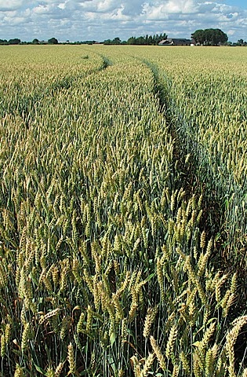
TOPICS:
Food security & genetic resources
Agricultural biodiversity informatics and GBIF
Agro-ecology and modelling
Predictive link between climate data and trait data
Selected examples of studies:
Morphology of Nordic barley
Net blotch on barley
Stem rust on wheat
Wheat at Alnarp, June 2010, CC-by Dag Endresen
Notes:
Photo: Wheat, Triticum aestivum L., at Nöbbelöv in Lund Sweden, June 2010 CC-by Dag Endresen. URL: http://www.flickr.com/photos/dag_endresen/4826175873/, https://picasaweb.google.com/dag.endresen/GermplasmCrops#5497796034327520578

Slide 3
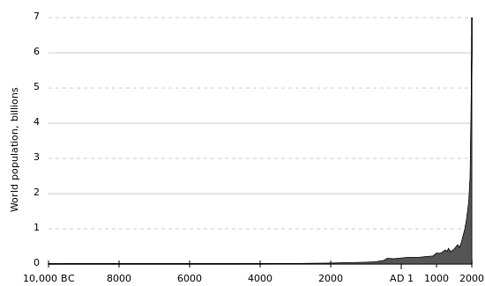
World human population (est.) 10,000 BC – 2000 AD.
To feed the human population in 2050 we will require agricultural production to increase by 70% globally, and 100% in developing countries.
(FAO, 2011; FAO, IFAD & WFP, 2014).
Industrial
age
(Industrial
agriculture)
Middle
ages
Origin of agriculture
Bronze age
Iron age
Illustration: Wiki Commons Public Domain.
FAO (2011). Looking ahead in world food and agriculture: Perspectives to 2050. . ISBN 978-92-5-106903-5 (p.272).
Notes:
Wiki Commons, Public Domain, http://en.wikipedia.org/wiki/File:Population_curve.svg
FAO (2011). Looking ahead in world food and agriculture: Perspectives to 2050. Edited by Piero Conforti. FAO, Economic and Social Development Department, Rome. ISBN 978-92-5-106903-5.
Page 235: “For these projections to materialize, annual world agricultural production would need to increase by 70 percent over the period from 2005/2007 to 2050”.
Page 272: “Nevertheless, agricultural production would still need to increase by 70 percent (and nearly 100 percent in developing countries) by 2050 to cope with a 40 percent increase in world population and to raise average food consumption to 3130 kcal per person per day by 2050. This translates into additional production of 1 billion tonnes of cereals and 200 million tonnes of meat a year by 2050 (compared with production in 2005/2007)”.
FAO, IFAD and WFP. 2014. The State of Food Insecurity in the World 2014. Strengthening the enabling environment for food security and nutrition. Rome, FAO. ISBN: 978-92-5-108543-1. http://www.fao.org/publications/sofi/2014/en/, http://www.fao.org/3/a-i4030e.pdf
FAO, IFAD and WFP. 2011. The State of Food Insecurity in the World 2011. How does international price volatility affect domestic economies and food security? Rome, FAO. ISBN: 978-92-5-106927-1. http://www.fao.org/docrep/014/i2330e/i2330e00.htm
Page 42: “FAO estimates indicate that global agricultural production will need to grow by 70 percent between 2005–07 and 2050, and by almost 100 percent in developing countries, to feed a population of more than 9 billion people in 2050”.
Alexandratos, N. and J. Bruinsma (2012). World agriculture towards 2030/2050: the 2012 revision. ESA Working paper No. 12-03. Rome, FAO.

Slide 4
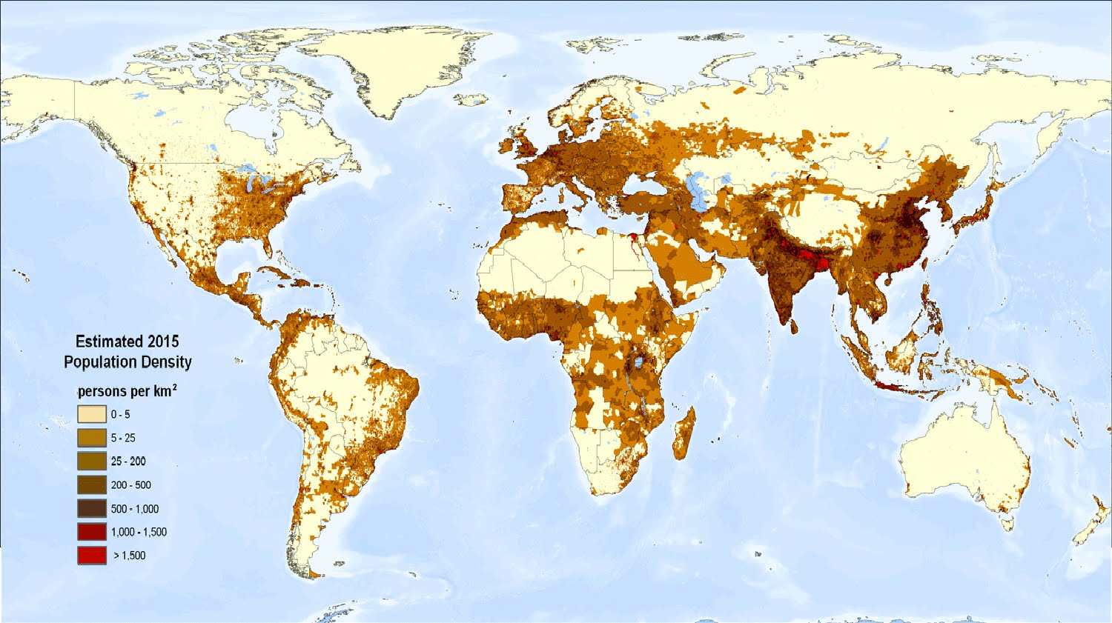
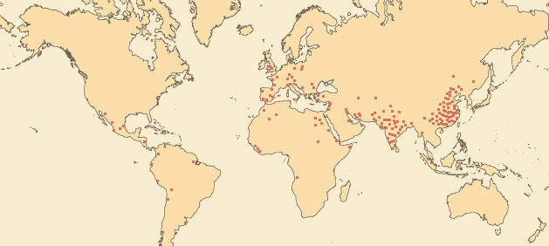
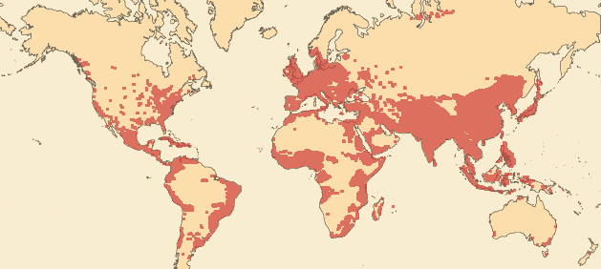
World population density (2015)
0 AD: 300 million people
1999: 6 billion people
Map by Alex E, available at Ecoclimax.com (2016)
Notes:
Map of World population density 2015, prepared by Alex E, available at Ecoclimax, http://www.ecoclimax.com/2016/10/population-density-of-world.html
Map of World population density 1994. Public Domain by U.S. department of agriculture, http://en.wikipedia.org/wiki/World_population#mediaviewer/File:World_population_density_1994.png
World population 2000, map: http://sedac.ciesin.columbia.edu/data/collection/gpw-v3/maps/gallery/search/7?facets=theme:population
http://www.fao.org/docrep/009/a0310e/A0310E06.htm

Slide 5
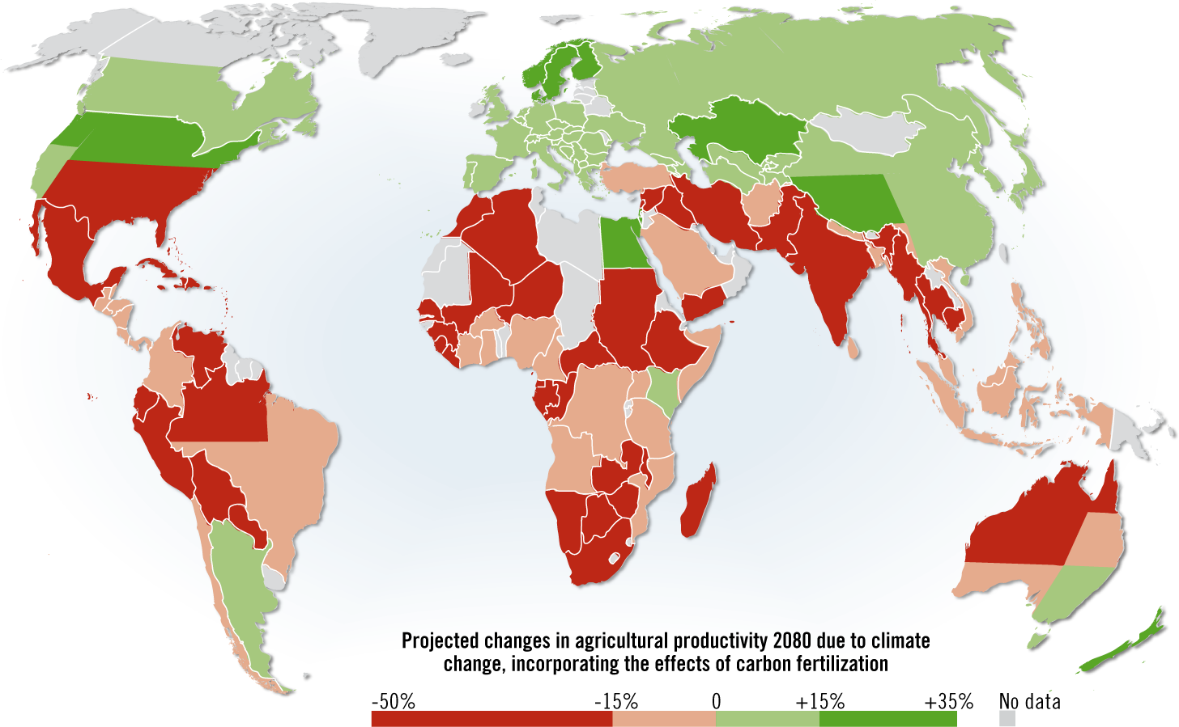
Projected impact of climate change on agricultural yields
Agricultural production will decrease by 2% each decade (IPCC AR5 WGII, 2014).
+ carbon fertilization
- evapotranspiration
Map by Hugo Ahlenius,
GRID-Arendal (2008).
Source: Cline W. (2007, 2008). Global Warming and Agriculture.
Notes:
Map: Hugo Ahlenius (2008). Projected agriculture in 2080 due to climate change. UNEP/GRID-Arendal. http://www.grida.no/graphicslib/detail/projected-agriculture-in-2080-due-to-climate-change_15f0
“Using this graphic and referring to it is encouraged, and please use it in presentations, web pages, newspapers, blogs and reports. For any form of publication, please include the link to this page and give the cartographer/designer credit (in this case Hugo Ahlenius, UNEP/GRID-Arendal)”.
Source: Cline, W. R. 2007. Global Warming and Agriculture: Impact Estimates by Country. Washington D.C., USA: Peterson Institute.
Africa: Kenya and Egypt are green – TODO: find out why. Kenya might get wetter, 18 out of 21 GCM models predict more rain Kenya.
--
William R. Cline (2007). Global Warming and Agriculture: Impacts estimated by country. Washington: Center for Global Development and
Peterson Institute for International Economics. ISBN 978-0-88132-403-7. http://bookstore.piie.com/book-store/4037.html, http://www.google.se/books?id=CwIQ-9YdjzQC
William R. Cline (2008). Global Warming and Agriculture. Finance and Development March 2008. https://www.imf.org/external/pubs/ft/fandd/2008/03/pdf/cline.pdf
MAP: Projected impact of climate change on agricultural yields (Cline, 2007): http://en.wikipedia.org/wiki/Climate_change_and_gender#mediaviewer/File:Projected_impact_of_climate_change_on_agricultural_yields_by_the_2080s,_compared_to_2003_levels_%28Cline,_2007%29.png
http://en.wikipedia.org/wiki/Climate_change_and_agriculture, http://en.wikipedia.org/wiki/Food_security
David B. Lobell, Marshall B. Burke, Claudia Tebaldi, Michael D. Mastrandrea, Walter P. Falcon, and Rosamond L. Naylor (2008). Prioritizing Climate Change Adaptation Needs for Food Security in 2030. Science 1 February 2008: 319 (5863), 607-610. [DOI:10.1126/science.1152339]
Anthony D Barnosky, James H Brown, Gretchen C Daily, Rodolfo Dirzo, Anne H Ehrlich, Paul R Ehrlich, Jussi T Eronen, Mikael Fortelius, Elizabeth A Hadly, Estella B Leopold, Harold A Mooney, John Peterson Myers, Rosamond L Naylor, Stephen Palumbi, Nils Chr Stenseth, and Marvalee H Wake (2014). Introducing the Scientific Consensus on Maintaining Humanity’s Life Support Systems in the 21st Century: Information for Policy Makers The Anthropocene Review April 2014 1: 78-109, doi:10.1177/2053019613516290
Intergovernmental Panel on Climate Change (IPCC) (2014). The Fifth Assessment Report (AR5). WG II: Impacts, Adaptation and Vulnerability – 31 March 2014.
http://www.ipcc.ch/report/ar5/index.shtml
IPCC AR5 (2014). Chapter 7. Food Security and Food production systems, http://ipcc-wg2.gov/AR5/images/uploads/WGIIAR5-Chap7_FGDall.pdf
“With low to medium confidence, they concluded that for about a 1 to 3 °C global mean temperature increase (by 2100, relative to the 1990–2000 average level) there would be productivity decreases for some cereals in low latitudes, and productivity increases in high latitudes”.
Cline (2008), https://www.imf.org/external/pubs/ft/fandd/2008/03/pdf/cline.pdf
“How climate affects agriculture: Climate change can affect agriculture in a variety of ways. Beyond a certain range of temperatures, warming tends to reduce yields because crops speed through their development, producing less grain in the process. And higher temperatures also interfere with the ability of plants to get and use moisture. Evaporation from the soil accelerates when temperatures rise and plants increase transpiration—that is, lose more moisture from their leaves. The combined effect is called “evapotranspiration.” Because global warming is likely to increase rainfall, the net impact of higher temperatures on water availability is a race between higher evapotranspiration and higher precipitation. Typically, that race is won by higher evapotranspiration. But a key culprit in climate change—carbon emissions—can also help agriculture by enhancing photosynthesis in many important, so-called C3, crops (such as wheat, rice, and soybeans). The science, however, is far from certain on the benefits of carbon fertilization. But we do know that this phenomenon does not much help C4 crops (such as sugar-cane and maize), which account for about one-fourth of all crops by value”. page 24.

Slide 6
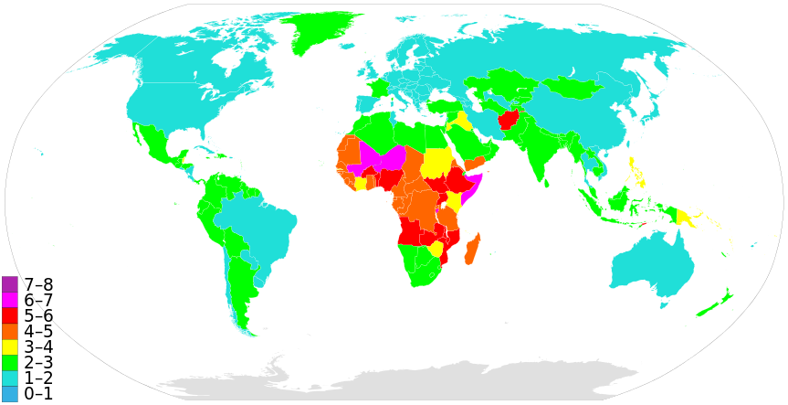

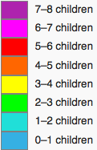
Population growth (total fertility rate)
Low population growth
Increased food production
(Cline 2007)
High population growth
Decreased food production
fertility rate
(Cline 2007)
CC-BY-SA Supaman89, Wiki Commons. Data from CIA World Fact Book (2014).
Notes:
CIA World Fact Book, Total fertility rate (TFR) compares figures for the average number of children that would be born per woman if all women lived to the end of their childbearing years and bore children according to a given fertility rate at each age. TFR is a more direct measure of the level of fertility than the crude birth rate, since it refers to births per woman.,
https://www.cia.gov/library/publications/the-world-factbook/rankorder/2127rank.html
https://www.cia.gov/library/publications/the-world-factbook/rankorder/rawdata_2127.txt
Map: http://en.wikipedia.org/wiki/World_population#mediaviewer/File:Countriesbyfertilityrate.svg, CC-BY-SA Supaman89, WikiCommons
Cline (2008), https://www.imf.org/external/pubs/ft/fandd/2008/03/pdf/cline.pdf

Slide 7

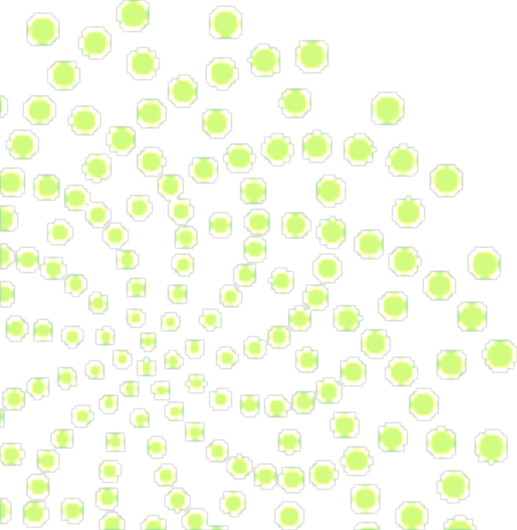
Food security is challenged by:
Population growth
Climate change

Slide 8
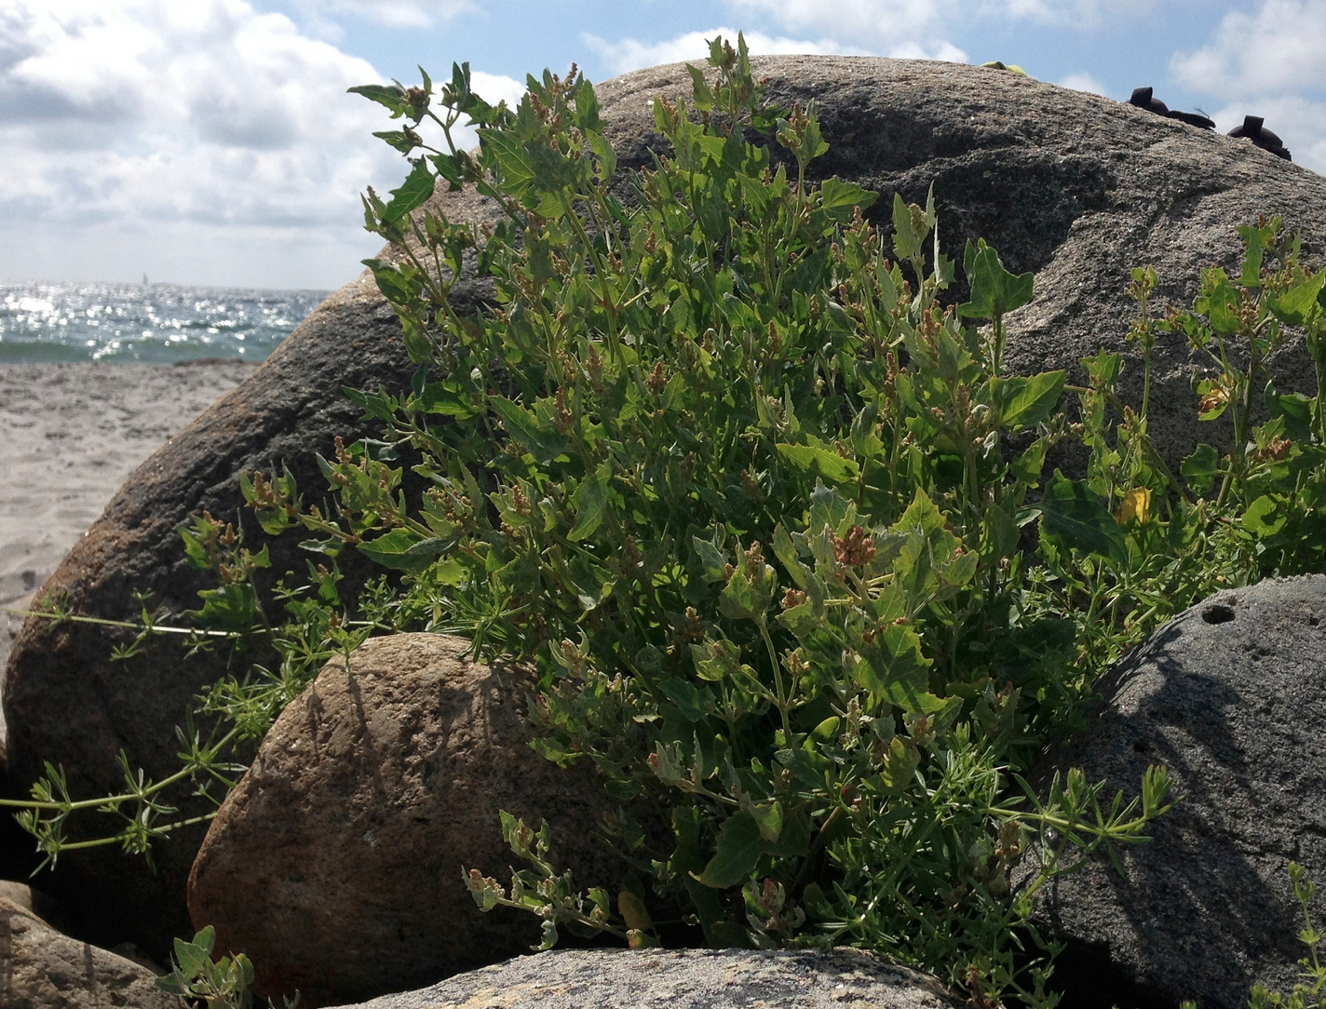
WE NEED CROPS:
with higher yields
with higher nutritional value
adapted to degraded lands
adapted to changing environments
Untapped genetic diversity can be found in:
Traditional cultivars, landraces
and Crop Wild Relatives!
Sea cale (Crambe maritima L.) at Spornes, Tromøy, Norway, July 2013, CC-by Dag Endresen.
Notes:
Illustration, Sea cale (Crambe maritima L.) at Spornes, Tromøy, Norway, July 2013. CC-by Dag Endresen, https://www.flickr.com/photos/dag_endresen/15300422265/
Nigel Maxted and Shelagh Kell (2009). Establishment of a Global Network for the In Situ Conservation of Crop Wild Relatives: Status and Needs. FAO, Rome.
http://www.fao.org/docrep/013/i1500e/i1500e18a.pdf
http://www.the-scientist.com/?articles.view/articleNo/40026/title/Wild-Relatives/

Slide 9
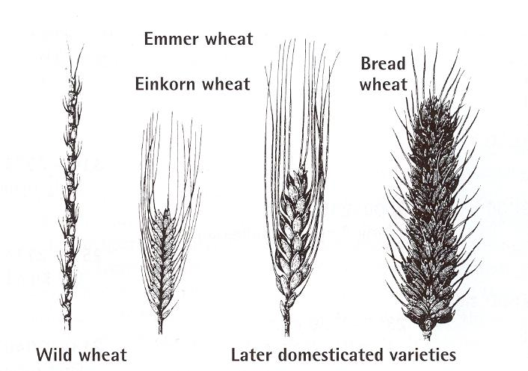
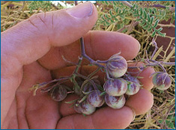
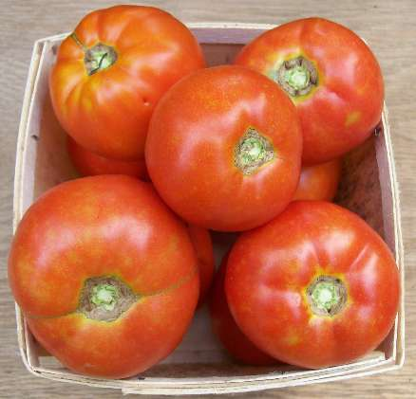
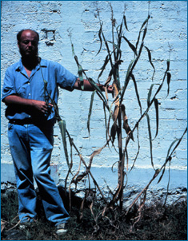
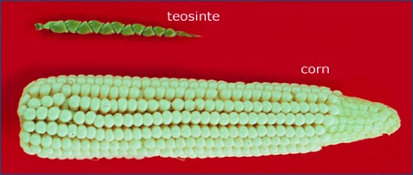
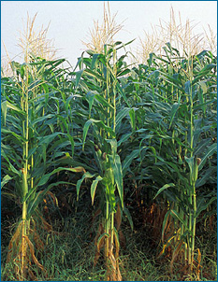
Domestication and cultivated plants: Utilizing genetic potential from the wild
wild tomato
cultivated tomato
wild teosinte
cultivation
cultivated
corn, maize
Notes:
Genetic resources from the wild relatives of the cultivated plants contributes the raw material required for domesticated forms and the further development of these food crops. Genebanks preserve and provides plant genetic resources for utilization by plant breeders and other bona fide use.

Slide 10
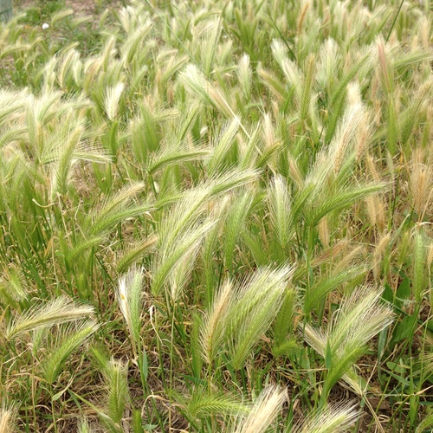
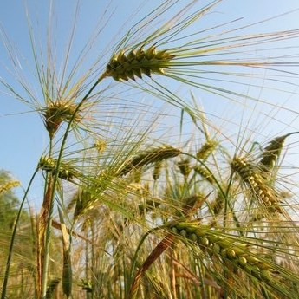
What are crop wild relatives?
Hare barley (Hordeum murinum ssp. leporinum) Sesimbra, Portugal April 2016 CC-BY Dag Endresen
Crop wild relatives (CWR) are wild plant species closely related to crops.
They have an indirect use as gene donors for crop improvement due to their relatively close genetic relationship to crops.
They are an important socio-economic resource that offer novel genetic diversity required to maintain future food security.
Broad definition (Maxted et al. 2006)
CWR = all taxa within the same genus as a crop
Maxted et al. 2006, doi:10.1007/s10531-005- 5409-6
Cultivated barley (Hordeum vulgare L.) June 2007, Gatersleben Germany CC-BY Dag Endresen
Notes:
Illustration: Hare barley (Hordeum murinum ssp. leporinum) Sesimbra, Portugal April 2016 CC-BY Dag Endresen, http://www.inaturalist.org/observations/3027829 http://www.gbif.org/occurrence/1306574202
Illustration: Cultivated barley (Hordeum vulgare) June 2007, Gatersleben Germany CC-BY Dag Endresen, http://www.inaturalist.org/observations/63715
--
Definition of Crop Wild Relative species (CWR)
"those wild plant taxa more or less closely related to species of direct socio-economic importance including food, fodder and forage crops, medicinal plants, condiments, ornamental and forestry species, as well as those related to crops used for industrial purposes such as oils and fibres" (Maxted et al. 2006). Crop wild relatives are used as a source of genes for plant improvement.
Maxted N, Ford-Lloyd BV, Jury SL, Kell SP, and Scholten MA (2006). Towards a definition of a crop wild relative. Biodiversity and Conservation 15: 2673–2685. doi:10.1007/s10531-005- 5409-6

Slide 11
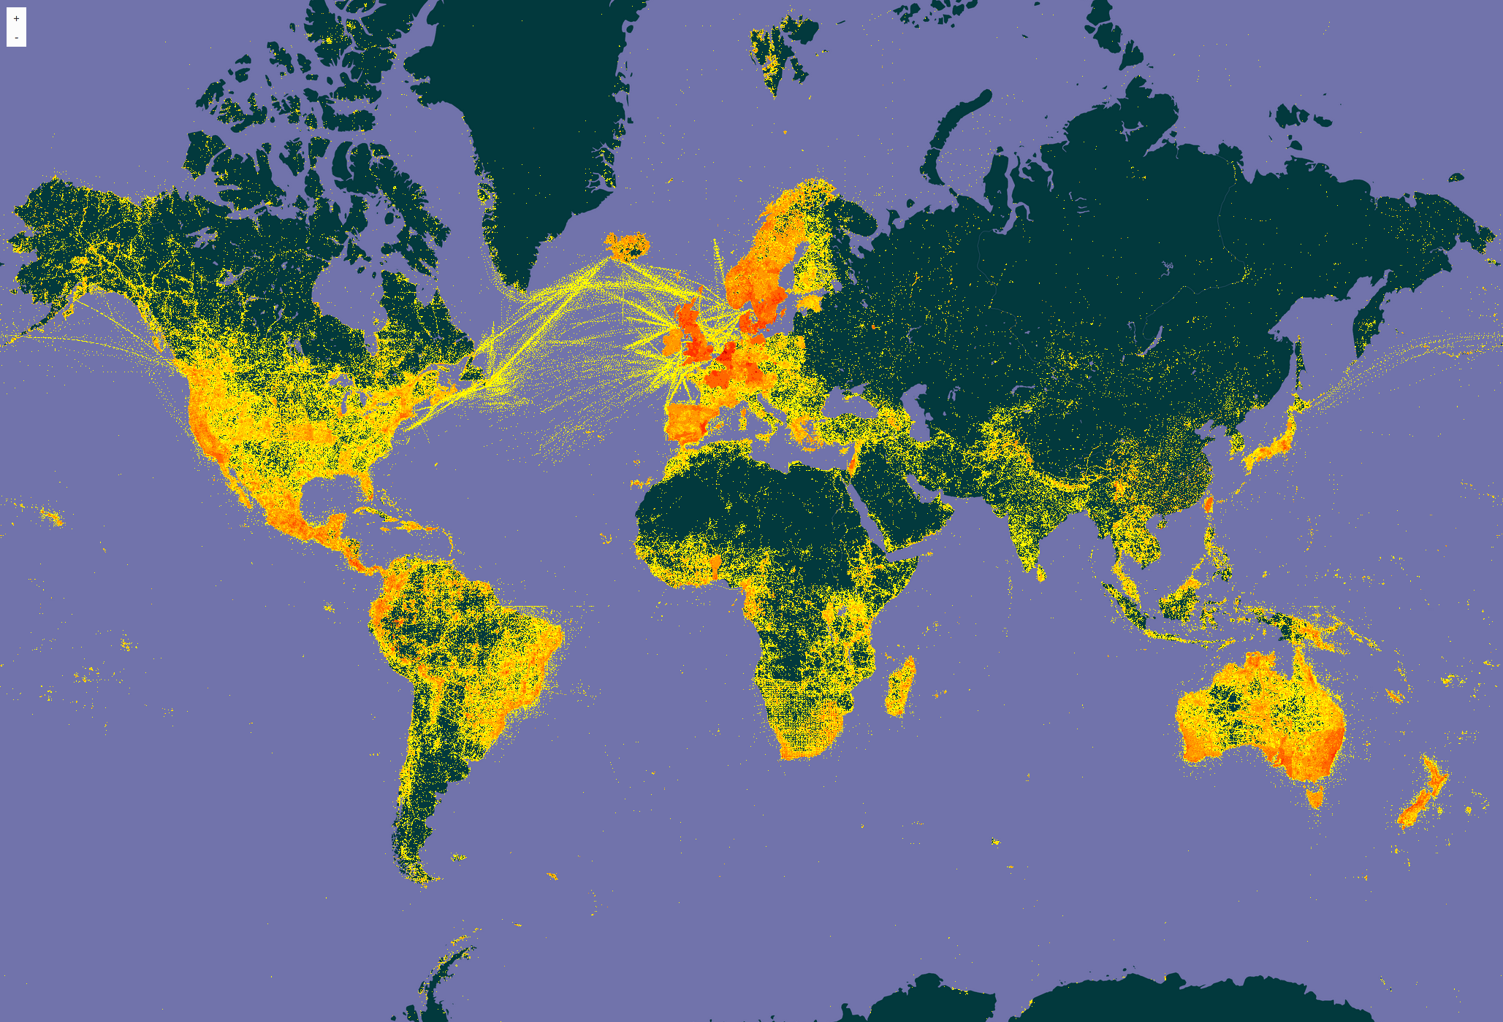

Crop Wild Relatives account for around 21% of the world’s flora (Maxted and Kell 2009)
Density of georeferenced plant species occurrence records published through GBIF (see http://www.gbif.org/species/6)
Last updated: 2017-06-08
Notes:
Illustration, GBIF Portal, filter for Plants, http://www.gbif.org/species/6, updated 2017-06-08
Nigel Maxted and Shelagh Kell (2009). Establishment of a Global Network for the In Situ Conservation of Crop Wild Relatives: Status and Needs. FAO, Rome.
http://www.fao.org/docrep/013/i1500e/i1500e18a.pdf
CWR account for around 21% of the world’s flora (Maxted and Kell 2009)
Their natural populations are becoming more threatened - 2 out of 10! (Kell et al. 2012)
Ramírez-Villegas J, Khoury C, Jarvis A, Debouck DG, Guarino L (2010) A Gap Analysis Methodology for Collecting Crop Genepools: A Case Study with Phaseolus Beans. PLoS ONE 5(10): e13497. doi:10.1371/journal.pone.0013497

Slide 12
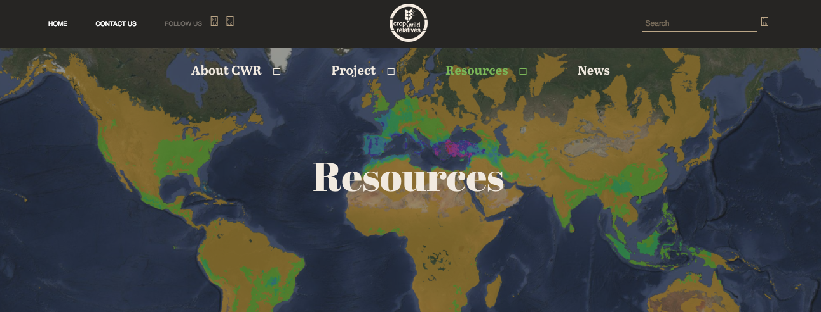


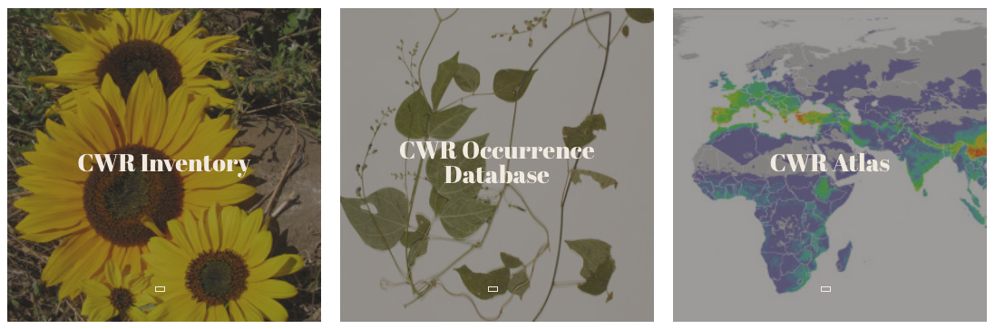
10-year, 50 mill USD
Notes:
http://www.cwrdiversity.org/checklist/cwr-occurrences.php
--
2010-12-10 Norway pledges support to CWR, providing 50 million USD
https://www.croptrust.org/press-release/norway-pledges-support-crop-wild-relatives/
http://www.bistandsaktuelt.no/nyheter/nyheter---tidligere-ar/2011/superplanter-skal-redde-verden/
--
2013-09-13 Norway providing 23.7 million USD to the Crop Trust endowment fund
https://www.croptrust.org/press-release/contribution-from-norway/#
2013-09-23 Reuters coverage of 23.7 million USD from Norway
https://www.croptrust.org/in-the-news/reuters-norway-invests-usd-23-7-million-crop-diversity/
--
2007-04-19, Gates Foundation provides 37.5 million USD to Crop Trust, Norway provides USD 7.5 million
https://www.croptrust.org/press-release/gates-foundation-funds-rescue-worlds-crop-biodiversity/#

Slide 13
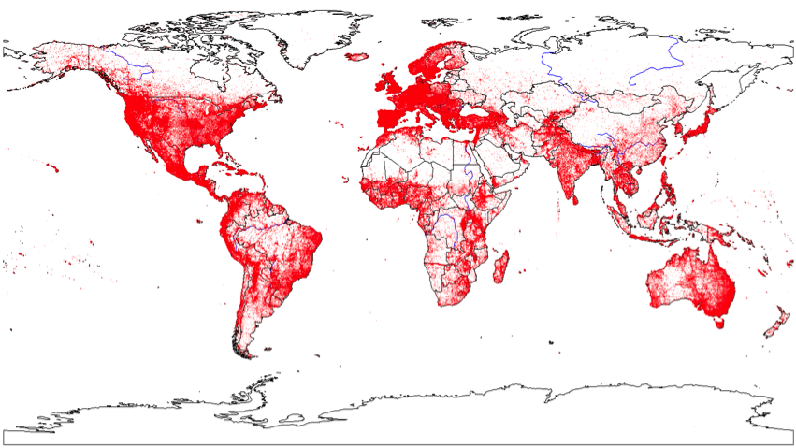
Global Atlas of Crop Wild Relatives
GBIF is the primary data source.
http://www.cwrdiversity.org/resources/
Notes:
Distribution of occurrence data in the global dataset of crop wild relatives (CWRDGC, 2015). This map was prepared with information mobilized via GBIF and other sources (i.e., herbaria, genebank databases, researchers archives), and includes crop wild relatives occurrence data and cultivated occurrence data, offering a picture of the current availability of ABD occurrence data. Map prepared by Steven Sotelo (CIAT).
http://www.cwrdiversity.org/resources/
Data source: GBIF and more

Slide 14
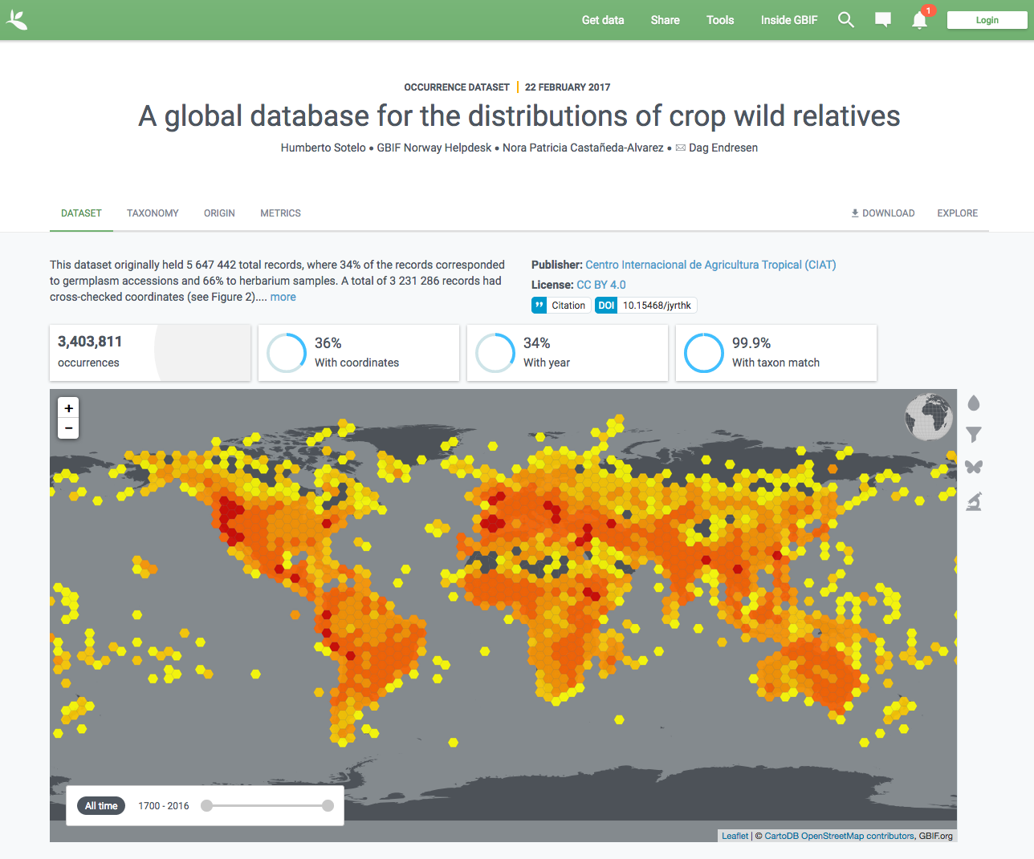

The Global Crop Wild Relative Occurrence Database include data from hundreds of data sources – including GBIF
The CWR Database was published in GBIF (2016)
(excluding the data records originating from GBIF)
doi:10.15468/jyrthk
Vincent et al.N (2013). A prioritized crop wild relative inventory to help underpin global food security. doi:10.1016/j.biocon.2013.08.011
Notes:
The Global Crop Wild Relative Occurrence Database
http://www.cwrdiversity.org/checklist/cwr-occurrences.php
https://doi.org/10.15468/jyrthk
http://www.gbif.org/dataset/07044577-bd82-4089-9f3a-f4a9d2170b2e/activity
--
Vincent H, Wiersema J, Kell S, Fielder H, Dobbie S, Castañeda-Álvarez NP, Guarino L, Eastwood R, Leon B, and Maxted N (2013). A prioritized crop wild relative inventory to help underpin global food security. Biological Conservation 167: 265–275. doi:10.1016/j.biocon.2013.08.011

Slide 15
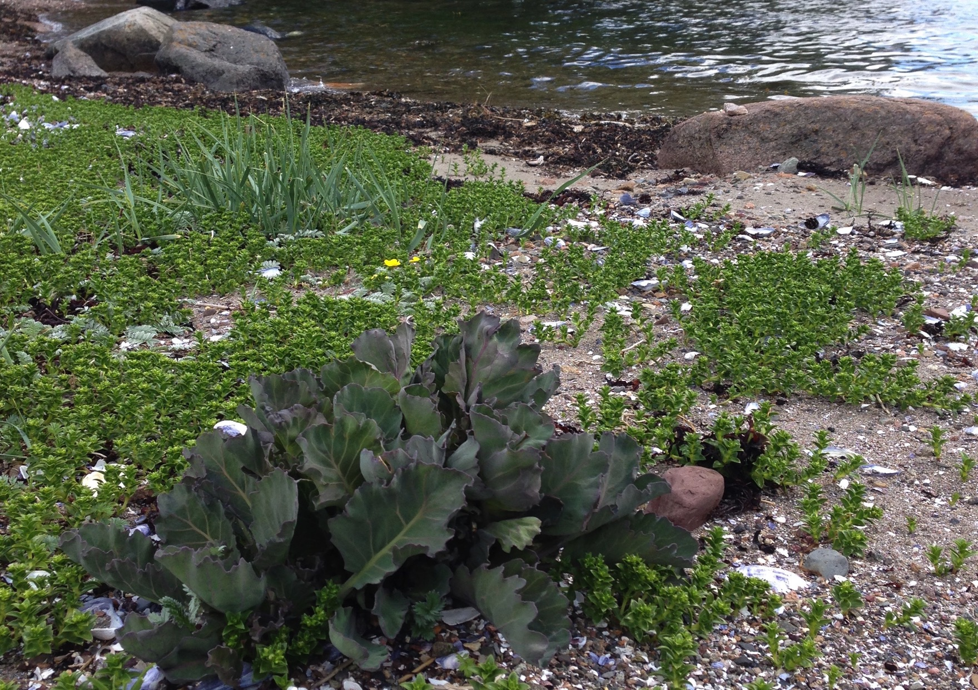

In situ conservation of PGR
In situ conservation is the on-site conservation or the conservation of genetic resources in natural populations of plant or animal species, such as forest genetic resources in natural populations.
https://en.wikipedia.org/wiki/In_situ_conservation
Sea cale population at Hvaløy, Færder national park, Vestfold, Norway, 27th May 2015, CC-BY Dag Endresen
Notes:
Sea cale population at Hvaløy, Færder national park, Vestfold, Norway, 27th May 2015, CC-BY Dag Endresen
https://en.wikipedia.org/wiki/In_situ_conservation
http://www.skogoglandskap.no/nyheter/2015/genressurser_bevares_i_farder_nasjonalpark%20/newsitem
https://prosjekt.fylkesmannen.no/Documents/Faerder/Dokument/H%C3%B8ring%20forvaltningsplan%20h%C3%B8st%202015/Vedlegg%2012%20In%20situ%20-%20genressursbevaring%20endelig.pdf

Slide 16
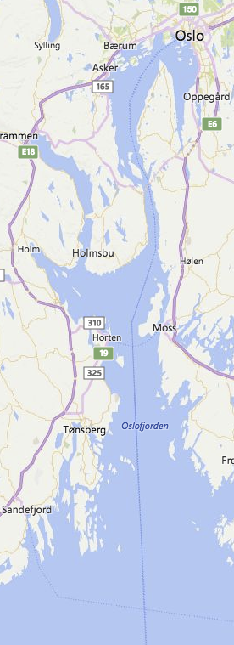
Færder national park – genetic reserve
Kap. 2.4 Planteliv og genressurser
Tanken om nasjonalparken som et genressursreservat er spennende selv om dette er uten forankring til noe lovverk. OF er som grunneier stolt av at øya Kløvningen er utvalgt som en av syv øyer i nasjonalparken som spesiell in situ bevaringslokalitet/genressursreservat og at øya fremover ønskes fulgt opp med grundige registreringer og overvåkning, jf vedlegg Færder nasjonalpark som genressursreservat.
Kommentar til Fylkesmannen i Vestfold, januar 2016 fra Friluftsrådet i Oslofjorden
https://www.fylkesmannen.no/Vestfold/Arkiv---Horinger/Forvaltningsplan-Farder-nasjonalpark/
Notes:
Sea cale population at Hvaløy, Færder national park, Vestfold, Norway, 27th May 2015, CC-BY Dag Endresen
https://en.wikipedia.org/wiki/In_situ_conservation
--
Færder nasjonalpark genressursreservat
http://www.skogoglandskap.no/nyheter/2015/genressurser_bevares_i_farder_nasjonalpark%20/newsitem
https://prosjekt.fylkesmannen.no/Documents/Faerder/Dokument/H%C3%B8ring%20forvaltningsplan%20h%C3%B8st%202015/Vedlegg%2012%20In%20situ%20-%20genressursbevaring%20endelig.pdf

Slide 17
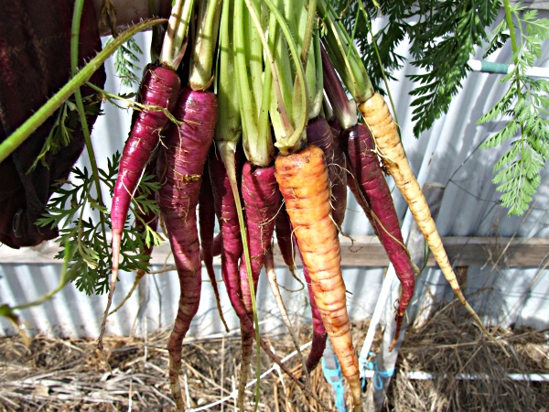
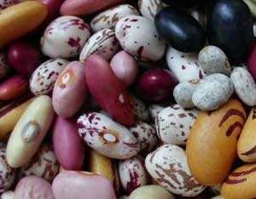
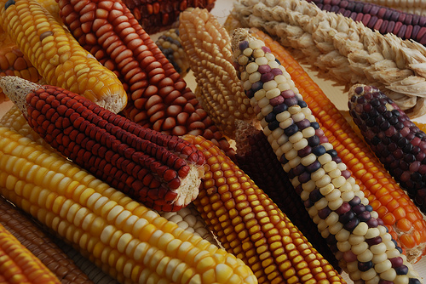
Landraces
Traditionally cultivated,
locally adapted, and
genetically diverse

Slide 18
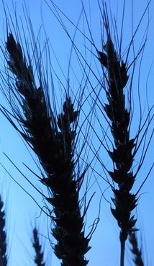
Traditional cultivars, landraces
“Landraces have a certain genetic integrity. They are recognizable morphologically; farmers have names for them and different landraces are understood to differ in adaptation to soil type, time of seeding, date of maturity, height, nutritive value, use and other properties. Most important, they are genetically diverse” (Harlan 1975).
"A landrace is a dynamic population(s) of a cultivated plant that has a historical origin, distinct identity and lacks formal crop improvement, as well as often being genetically diverse, locally adapted and associated with traditional farming systems" (Villa et al. 2005).
Notes:
Illustration: Hare barley (Hordeum murinum ssp. leporinum) Sesimbra, Portugal April 2016 CC-BY Dag Endresen, http://www.inaturalist.org/observations/3027829 http://www.gbif.org/occurrence/1306574202
Illustration: Cultivated barley (Hordeum vulgare) June 2007, Gatersleben Germany CC-BY Dag Endresen, http://www.inaturalist.org/observations/63715
Definition of Crop Wild Relative species (CWR)
"those wild plant taxa more or less closely related to species of direct socio-economic importance including food, fodder and forage crops, medicinal plants, condiments, ornamental and forestry species, as well as those related to crops used for industrial purposes such as oils and fibres" (Maxted et al. 2006). Crop wild relatives are used as a source of genes for plant improvement.
Definition of Landrace
“Landraces have a certain genetic integrity. They are recognizable morphologically; farmers have names for them and different landraces are understood to differ in adaptation to soil type, time of seeding, date of maturity, height, nutritive value, use and other properties. Most important, they are genetically diverse” (Harlan 1975).
Harlan, J.R. (1975) Our vanishing genetic resources. Science 188: 618–621. DOI: 10.1126/science.188.4188.617
"A landrace is a dynamic population(s) of a cultivated plant that has a historical origin, distinct identity and lacks formal crop improvement, as well as often being genetically diverse, locally adapted and associated with traditional farming systems" (Villa et al. 2005).
Villa TCC, Maxted N, Scholten M, and Ford-Lloyd B (2005). Defining and identifying crop landraces. Plant Genetic Resources: Characterization and Utilization 3(3): 373- 384. doi:10.1079/PGR200591

Slide 19
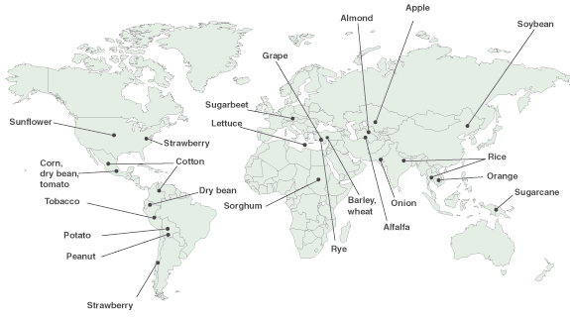
Centers of origin for selected crops
can provide places to search for traditional cultivars & CWRs
Map public domain by the United States Department of Agriculture (USDA).
http://commons.wikimedia.org/wiki/File:Feature2originmap600.png
Notes:
Centers of origin of selected crops. Note: The pointer locations indicate general regions where crops are believed to have first been domesticated. In some cases, the center of origin is uncertain. Other geographic regions also harbor important genetic diversity for these crops. Source: This map was developed by the General Accounting Office using data provided by the National Plant Germplasm System´s Exchange Office.
Map Public Domain: http://commons.wikimedia.org/wiki/File:Feature2originmap600.png
http://www.digitalhistory.uh.edu/active_learning/explorations/columbus/columbian_answers_plants.cfm

Slide 20
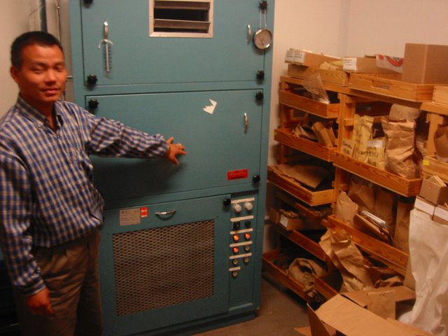
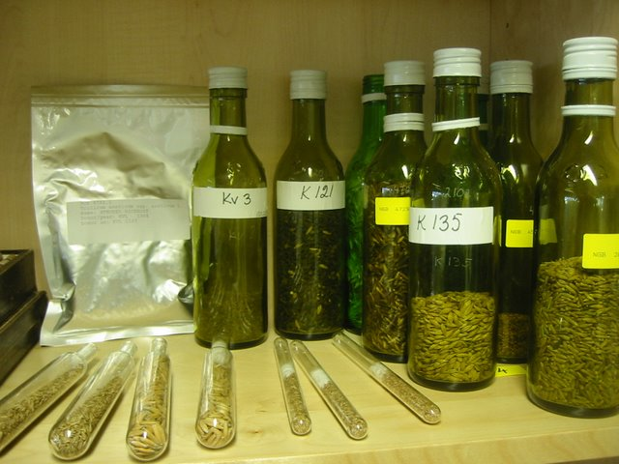
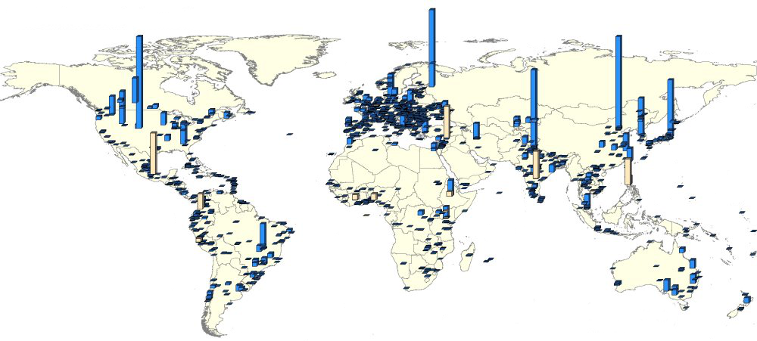
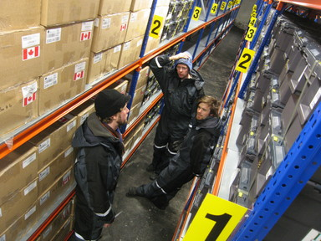
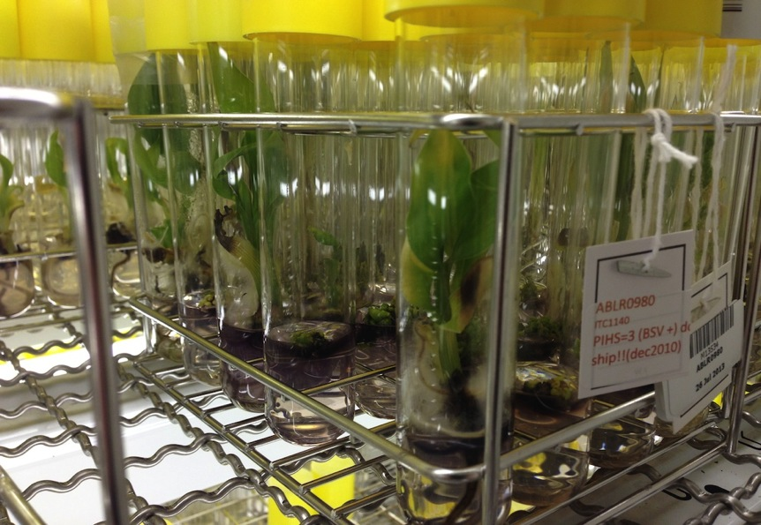
Ex situ genebank collections for plant genetic resources
Seed drying room
Alnarp
Seed containers
Alnarp
Svalbard Global
Seed Vault
Musa in vitro
Leuven
Notes:
More than 7.4 million genebank accessions; and more than 1400 genebanks - including approximately 140 large genebanks each holding more than 10.000 accessions: Second Report on the State of the World’s Plant Genetic Resources for Food and Agriculture (2010) Food and Agriculture Organization of the United Nations (FAO).
Map of genebanks: http://apps3.fao.org/wiews/wiews.jsp, http://apps3.fao.org/wiews/img/gbanksall.jpg, http://apps3.fao.org/wiews/img/gbanks130.jpg

Slide 21
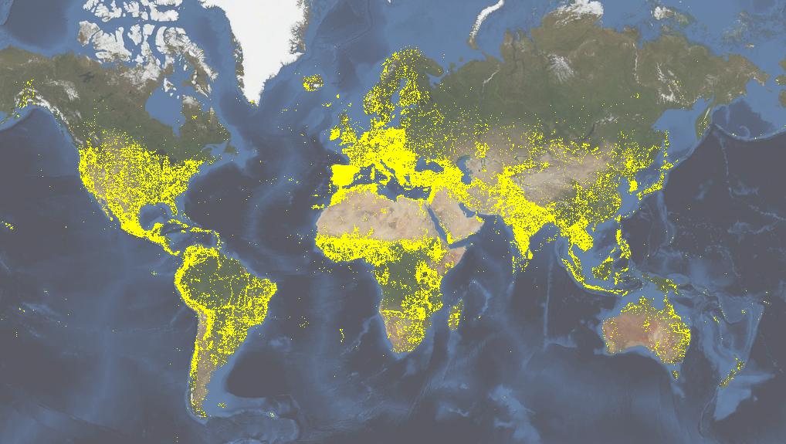
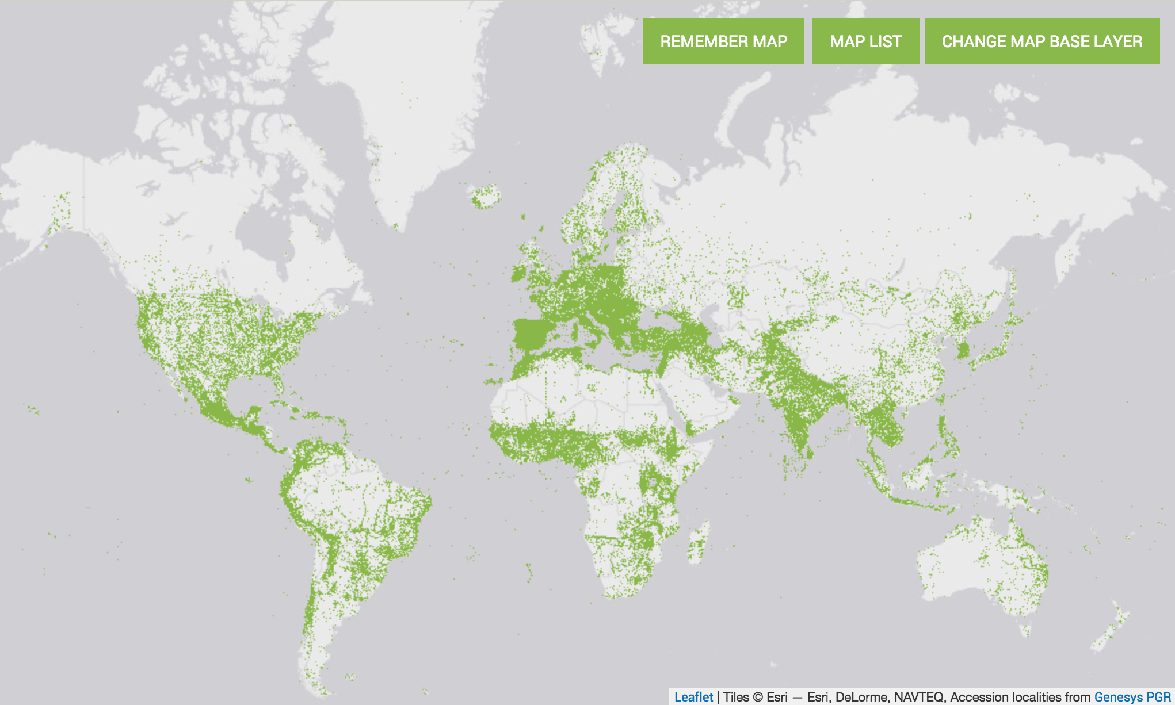
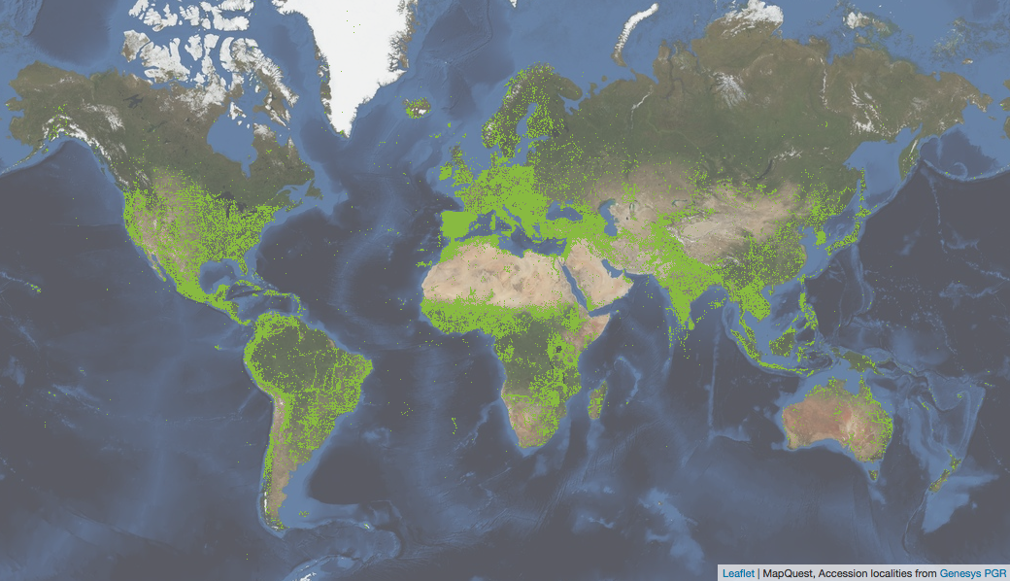



www.genesys-pgr.org
2,601,831 germplasm accessions worldwide
434 institutes – 252 countries (status November 2017)
Notes:
GeneSys, status November 2017: 2,616,328 accessions : 447 institutes : 252 countries, http://www.genesys-pgr.org/
GeneSys, status November 2015: 2,616,328 accessions : 447 institutes : 252 countries, http://www.genesys-pgr.org/
GeneSys, status October 2014: 2,802,770 accessions : 446 institutes : 252 countries, http://www.genesys-pgr.org/

Slide 22
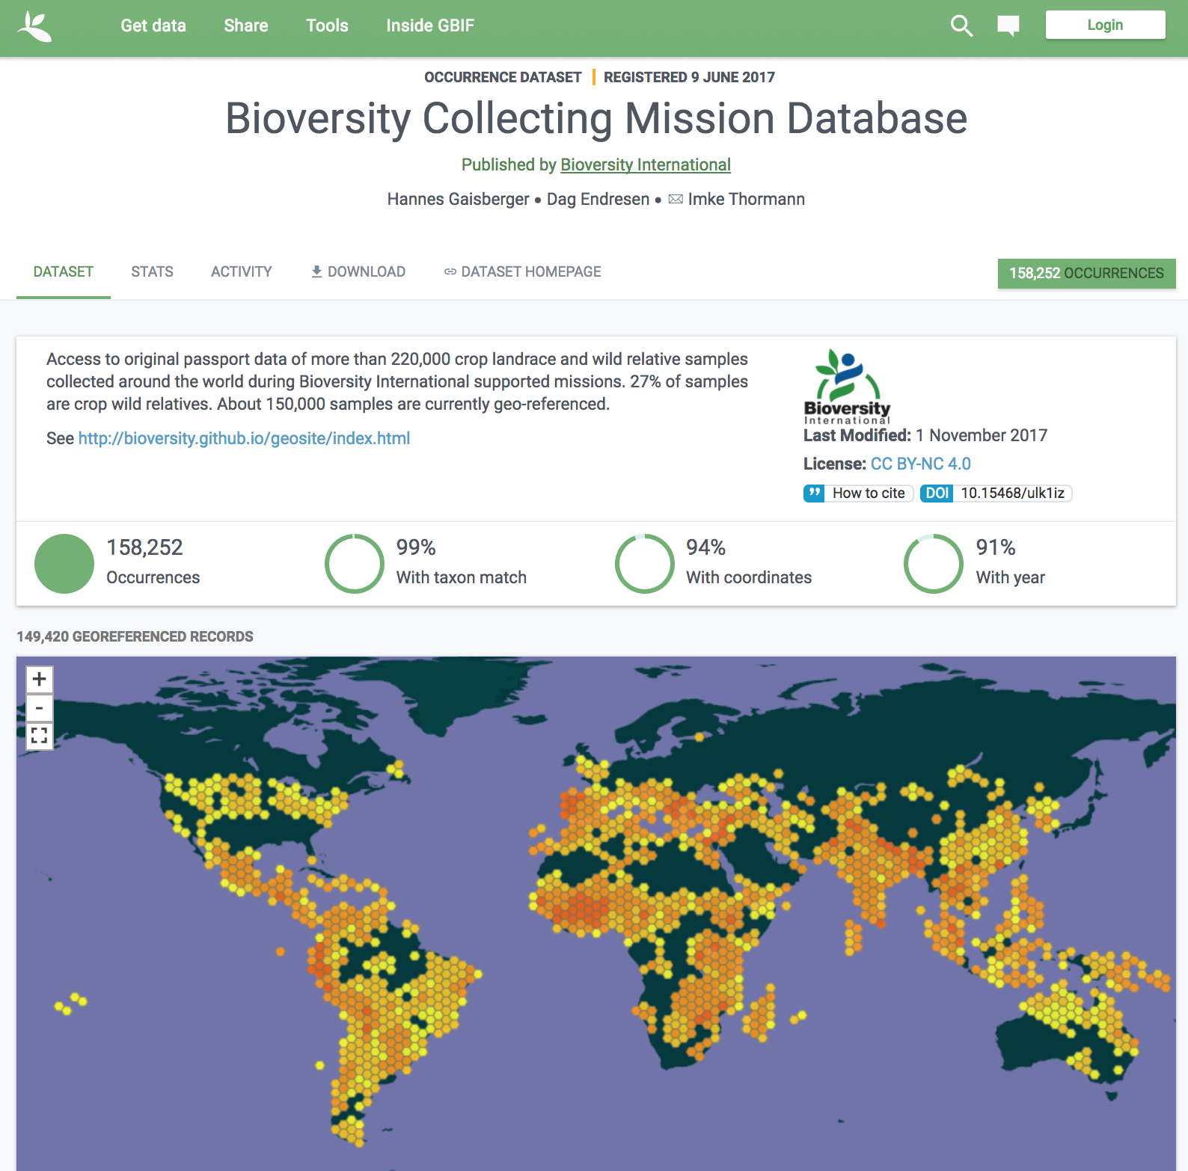

Biodiversity Collecting Mission Database
158 252 occurrences
doi:10.15468/ulk1iz
(Dataset published in GBIF June 2017)
Notes:
Gaisberger H, Endresen D (2017). Bioversity Collecting Mission Database. Version 1.8. Bioversity International. Occurrence Dataset https://doi.org/10.15468/ulk1iz accessed via GBIF.org on 2017-11-15.

Slide 23


Nordic crop wild relative conservation strategies

Slide 24










Nordic Crop Wild Relatives
EU funded “PGR Secure” (2011-2014)
NMR funded project “Ecosystem services: Genetic resources and crop wild relatives” (2015-2016)
NMR funded project “Wild genetic resources – a tool to meet climate change” (2017-2018)
Notes:
* Palmé, Anna; Fitzgerald, Heli; Weibull, Jens; Asdal, Åsmund; Lund, Birgitte; Endresen, Dag Terje Filip; Kiviharju, Elina; Þorbjörnsson, Hjörtur; Rasmussen, Morten & Carlson-Nilsson, Ulrika (2017). A Nordic regional approach for crop wild relative (CWR) conservation. http://www.nordgen.org/ngdoc/NordicCWR_2016/Poster_EUCARPIA_2017_final.pdf
* Fitzgerald, Heli; Palmé, Anna; Aronsson, Mora; Endresen, Dag Terje Filip; Weibull, Jens; Asdal, Åsmund; Þorbjörnsson, Hjörtur; Ramussen, Morten; Lund, Birgitte & Kiviharju, Elina (2017). Nordic Crop Wild Relative (CWR) Checklist. https://doi.org/10.15468/itkype
* Weibull, J., Fitzgerald, H., Lund, B., Palmé, A. and Þorbjörnsson, H. (2016), Conservation and sustainable use of crop wild relatives: a Nordic initiative. Sveriges Utsädesförenings Tidskrift 2: 53-58.

Slide 25
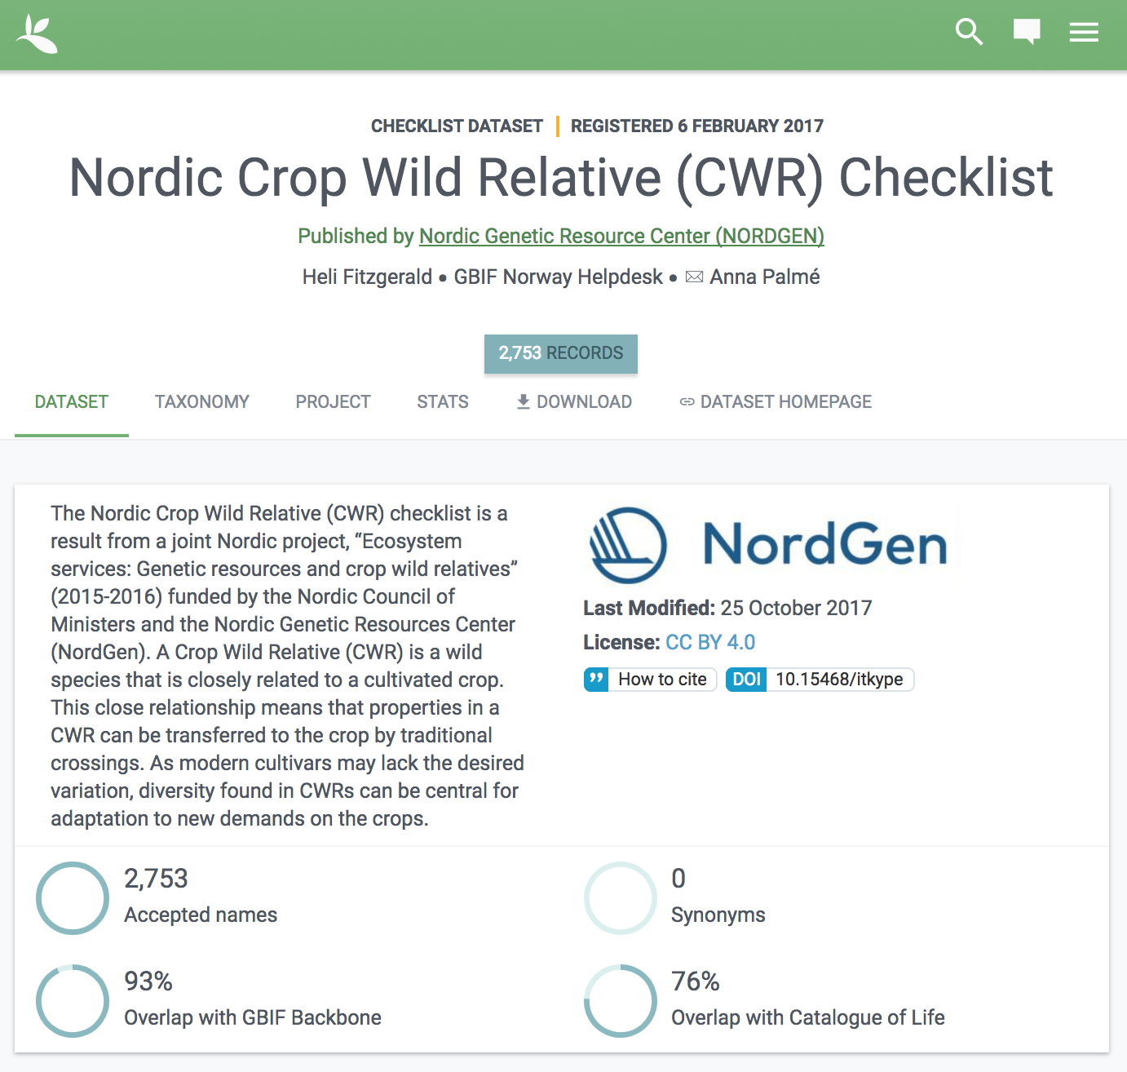
The Nordic Crop Wild Relative (CWR) Checklist is published in GBIF (2017)
doi:10.15468/itkype
Nordic CWR conservation priorities are developed using GBIF-mediated data.
Notes:
Fitzgerald H, Helpdesk GBIF.no (2017). Nordic Crop Wild Relative (CWR) Checklist. Version 1.10. Nordic Genetic Resource Center (NORDGEN). Checklist Dataset https://doi.org/10.15468/itkype accessed via GBIF.org on 2017-11-15.

Slide 26
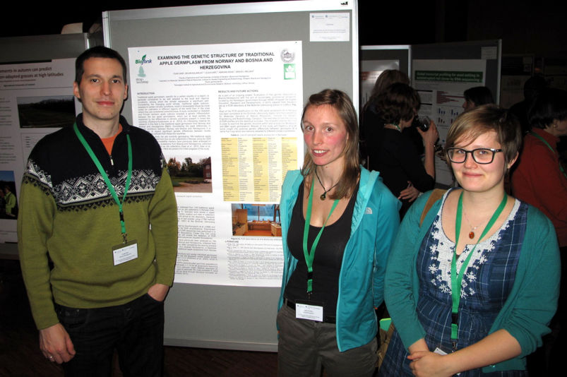

Lillehammer, 2014
Photo: Åsmund Asdal
Fuad Gasi, Jade Phillips (UK) & Karen Jordal (UiO NHM)
Conference at Lillehammer, 27. january 2014: Genetic Resources for Food and Agriculture in a Changing Climate, http://climate.nordgen.org/
Notes:
Konferanse på Lillehammer, 27. januar 2014: Genetic Resources for Food and Agriculture in a Changing Climate, http://climate.nordgen.org/
Foto: Deltagere i Genressurssenterets samarbeidsprosjekter var med på konferansen; Fuad Gasi (t.v) presenterte en poster om DNA-testing av norske eplesorter ved Universitetet i Sarajevo, Jade Phillips fra Universitetet i Birmingham holdt foredrag om in situ bevaring av nyttige planter i norsk natur og Karen Jordal starter i disse dager på en mastergrad ved Universitetet i Oslo innen modellering av behov for ex situ bevaring av ville nytteplanter. (Foto: Åsmund Asdal, Skog og landskap). Hage.no: http://www.bygg.no/hage/article/1182007
-----
http://www.nhm.uio.no/forskning/aktuelt/arrangementer/mastereksamen/Jordal.html
http://www.mn.uio.no/ibv/studier/aktuelt/mastereksamen/var-2017/karen-jordal.html
--
Karen Jordal Master of Science (MSc). BIOLOGI MASTER (Økologi og Evolusjon ) Tid og sted: 3. juli 2017 11:00, Auditorium i Lids hus
Oppgavens tittel: ”Data fitness for use in conservation planning. Conservation of crop wild relatives in Norway.”
Veiledere: Førsteamanuensis Anders Bryn; Dag Endresen. GBIF.no; Åsmund Aasmund, NIBIO/NordGen
Bedømmelseskomité: Intern sensor: Førstelektor Anneleen Kool; Ekstern sensor: Seniorforsker Vegar Bakkestuen, NINA

Slide 27
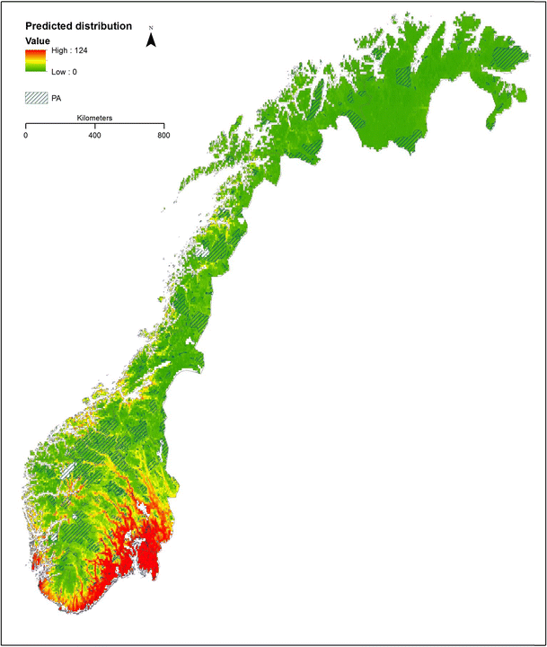



CWR conservation in Norway
Development of a conservation plan for Crop Wild Relatives in Norway using CWR species occurrence data points from GBIF.
Species richness of 201 priority CWR.
Based on 592,705 records from GBIF.
Oslo and south east region have highest CWR taxonomic diversity.
Phillips J, Brehm JM, van Oort B, Asdal Å, Rasmussen M, & Maxted N (2017) Climate change and national crop wild relative conservation planning. Ambio. DOI:10.1007/s13280-017-0905-y
Phillips J, Asdal Å, Brehm JM, Rasmussen M, & Maxted N (2016) In situ and ex situ diversity analysis of priority crop wild relatives in Norway. Diversity and Distributions 22: 1112–1126. DOI: 10.1111/ddi.12470
Asdal Å, Philips J, & Maxted N (2013). Boost for crop wild relative conservation in Norway. Crop Wild Relative 9: 20-21. ISSN 1742-3694.
http://www.gbif.org/newsroom/uses/2016-phillips-et-al
Figure. The predicted distribution of 187 priority CWR in Norway under the current climatic conditions. Red areas indicate taxon-rich areas with up to 124 taxa found there, and green areas indicate low taxon richness. Raster grid cell size 0.0416, approximately equal to 4 × 8 km2 (Philips et al. 2017)
Notes:
http://www.gbif.org/newsroom/uses/2016-phillips-et-al
Philips et al 2016, 2017; doi:10.1007/s13280-017-0905-y
Figure. The predicted distribution of 187 priority CWR in Norway under the current climatic conditions. Red areas indicate taxon-rich areas with up to 124 taxa found there, and green areas indicate low taxon richness. Raster grid cell size 0.0416, approximately equal to 4 × 8 km2 (Philips et al. 2017)
--
Norwegian Forest and Landscape Institute - Norwegian Genetic Resource Centre.
Asdal, Å, Philips, J., Maxted, N. (2013). Boost for crop wild relative conservation in Norway. Crop Wild Relative 9: 20-21. ISSN 1742-3694.http://www.pgrsecure.bham.ac.uk/sites/default/files/documents/newsletters/CWR_Issue_9.pdf
Phillips J, Kyratzis A, Christoudoulou C, Kell S, and Maxted N (2013). Development of a national crop wild relative conservation strategy for Cyprus. Crop Wild Relative 9: 20-21. ISSN 1742-3694.
Phillips J, Kyratzis A, Christoudoulou C, Kell S, and Maxted N (2014). Development of a national crop wild relative conservation strategy for Cyprus. Genetic Resources and Crop Evolution 61(4): 817-827. doi:10.1007/s10722-013-0076

Slide 28
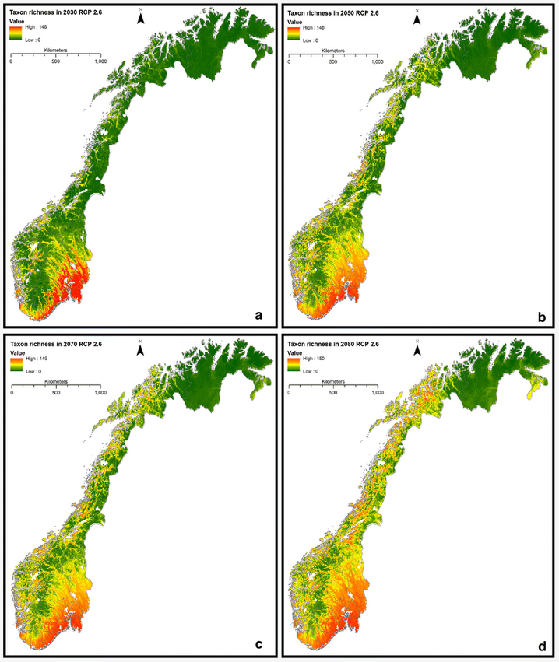
CWR conservation in Norway
Development of a conservation plan for Crop Wild Relatives in Norway with extracted CWR species occurrence data points from GBIF.
Phillips, J., Magos Brehm, J., van Oort, B. Asdal, Å., Rasmussen, M., Maxted, N. (2017) Climate change and national crop wild relative conservation planning. Ambio. DOI:10.1007/s13280-017-0905-y
Phillips, J., Asdal, Å., Brehm, J.M., Rasmussen M., Maxted, N. (2016) In situ and ex situ diversity analysis of priority crop wild relatives in Norway. Diversity and Distributions, 22, 1112–1126. DOI: 10.1111/ddi.12470
2030
2050
2070
2080
Figure. The average predicted taxon richness of 187 priority CWR in Norway under RCP 2.6 for the years a 2030, b 2050, c 2070, d 2080. Raster grid cell size 0.0416, approximately equal to 4 × 8 km² (Philips et al. 2017)
http://www.gbif.org/newsroom/uses/2016-phillips-et-al
Notes:
http://www.gbif.org/newsroom/uses/2016-phillips-et-al
Philips et al 2016, 2017; doi:10.1007/s13280-017-0905-y
Figure. The average predicted taxon richness of 187 priority CWR in Norway under RCP 2.6 for the years a 2030, b 2050, c 2070, d 2080. Raster grid cell size 0.0416, approximately equal to 4 × 8 km² (Philips et al. 2017)
--
Figure. The predicted distribution of 187 priority CWR in Norway under the current climatic conditions. Red areas indicate taxon-rich areas with up to 124 taxa found there, and green areas indicate low taxon richness. Raster grid cell size 0.0416, approximately equal to 4 × 8 km2 (Philips et al. 2017)

Slide 29
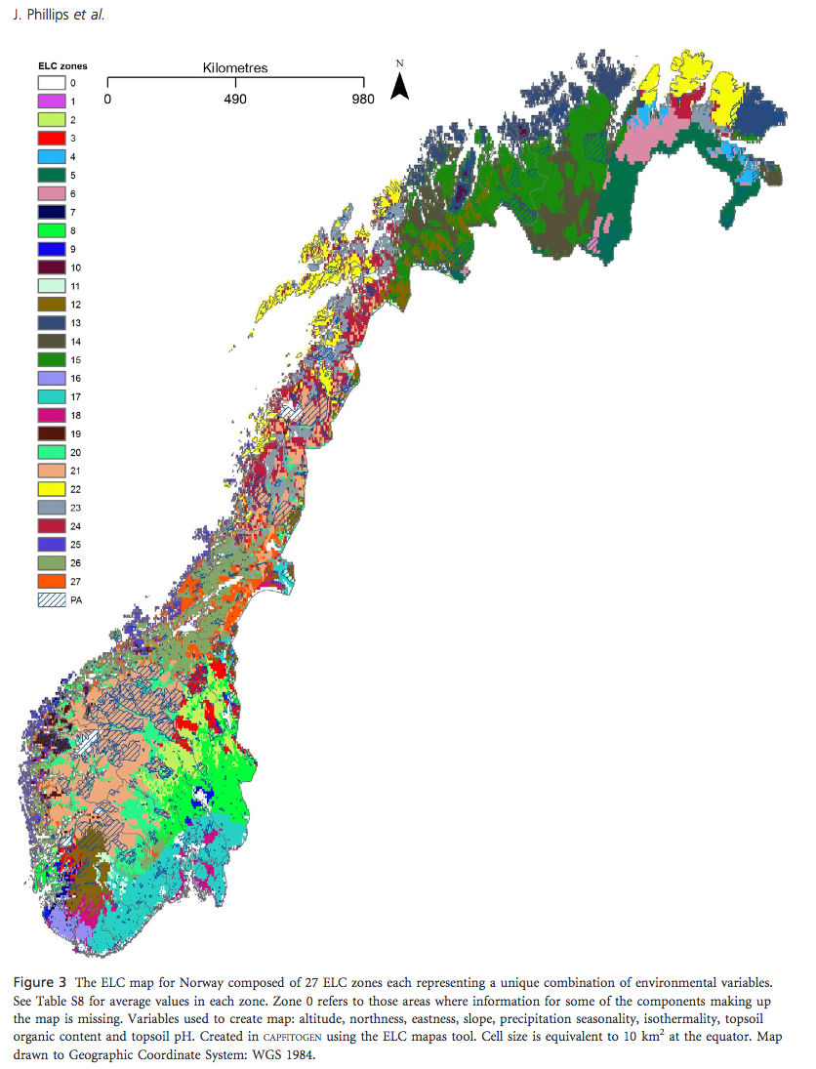
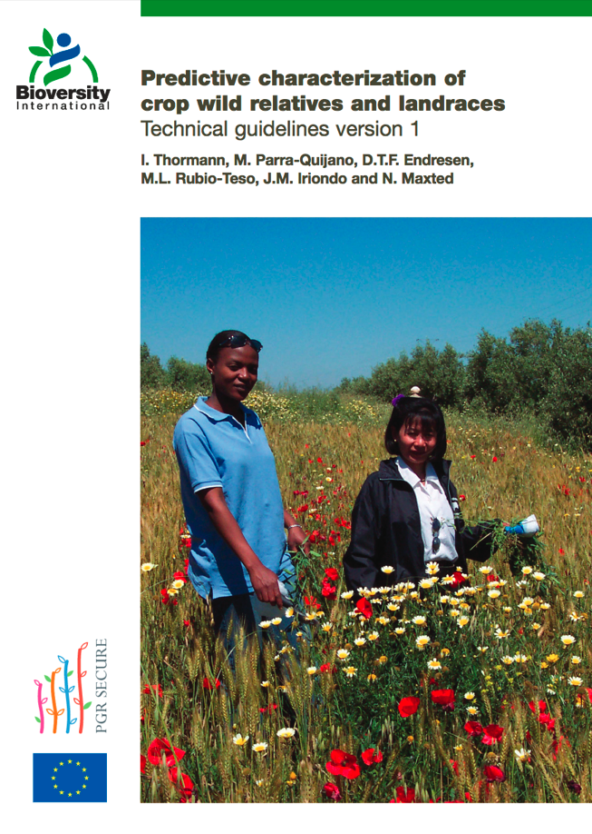
ELC maps
Development of a Ecological Land Characterization (ELC) maps using species occurrence data points from GBIF
Thormann, I.; Parra-Quijano, M.; Endresen, D.T.F.; Rubio-Teso, M.L.; Iriondo, J.M., & Maxted, N. (2014). Predictive characterization of crop wild relatives and landraces: Technical guidelines version 1. Bioversity International. ISBN 978-92-9255-004-2.
Phillips, J., Asdal, Å., Brehm, J.M., Rasmussen M., & Maxted, N. (2016) In situ and ex situ diversity analysis of priority crop wild relatives in Norway. Diversity and Distributions, 22, 1112–1126. DOI: 10.1111/ddi.12470
Phillips, J., Magos Brehm, J., van Oort, B. Asdal, Å., Rasmussen, M., & Maxted, N. (2017) Climate change and national crop wild relative conservation planning. Ambio. DOI:10.1007/s13280-017-0905-y
Notes:
http://www.gbif.org/newsroom/uses/2016-phillips-et-al
Philips et al 2016, 2017; doi:10.1007/s13280-017-0905-y

Slide 30
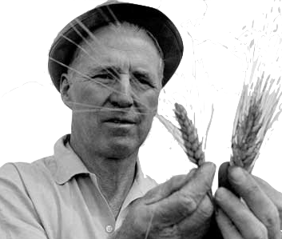
Fitness for scientific use of GBIF-mediated data

Slide 31
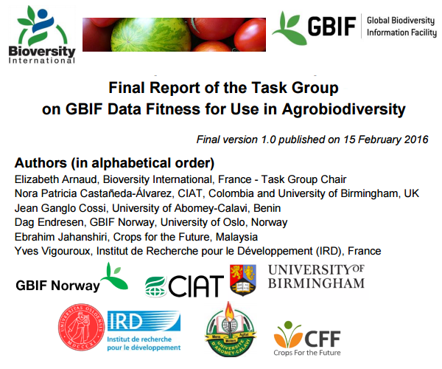
GBIF and Bioversity (2016) Final report of the task group on GBIF data fitness for use in agrobiodiversity. Global Biodiversity Information Facility, Copenhagen. http://www.gbif.org/resource/82283
Notes:
GBIF and Bioversity (2016) Final report of the task group on GBIF data fitness for use in agrobiodiversity. Global Biodiversity Information Facility, Copenhagen. http://www.gbif.org/resource/82283
https://cgspace.cgiar.org/handle/10568/77851 & https://www.duo.uio.no/handle/10852/50041
News story:
http://www.gbif.org/newsroom/news/agrobiodiversity_report

Slide 32
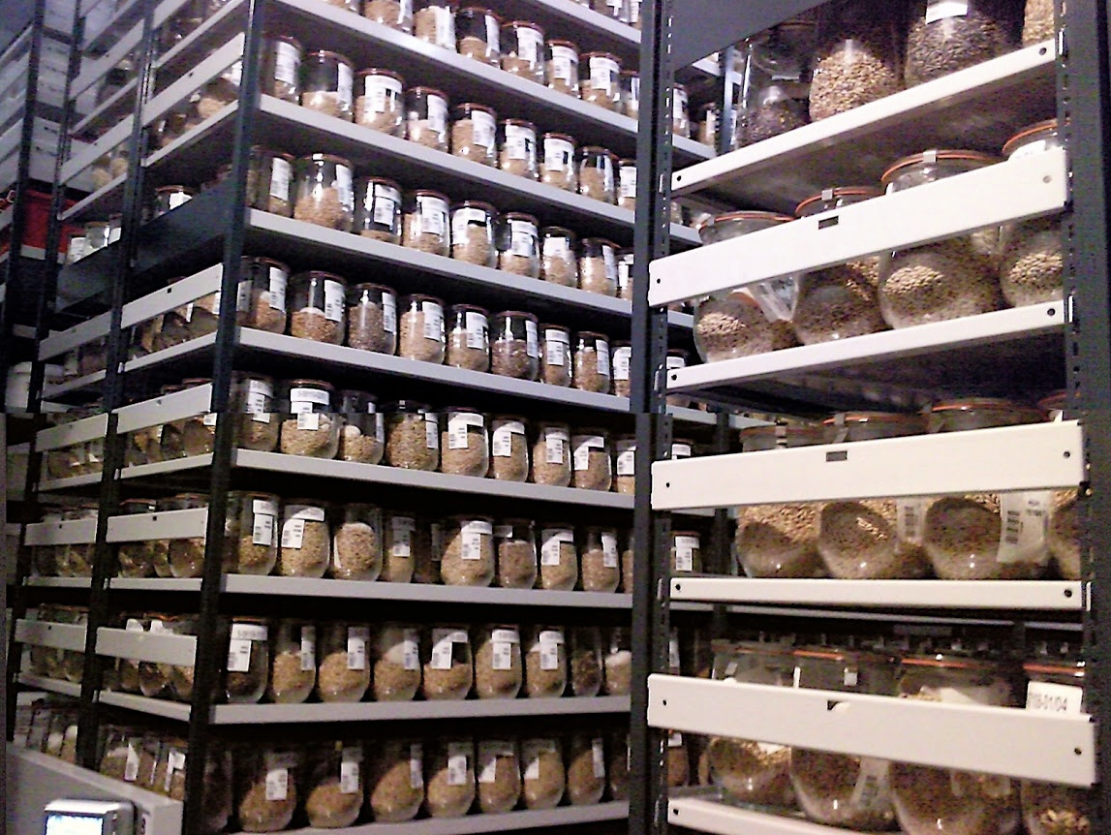


Searching for traits of resistance to crop diseases and pests in wheat and barley landraces
Dag Endresen
GBIF Norway, University of Oslo
Notes:
Illustration photo: IPK Gatersleben genebank cold storage, photo by Dag Endresen, May 2010, Gatersleben, Germany, CC-by.
Predictive characterization of wheat and barley landraces
Searching for traits of resistance to crop diseases and pests in wheat and barley landraces
Focused Identification of Germplasm Strategy (FIGS) analysis for the wild relatives of the cultivated plants.
Presented by Dag Endresen, GBIF Norway, University of Oslo

Slide 33
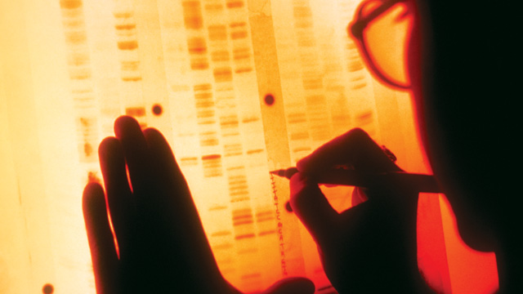
Predictive characterization
Focused Identification of Germplasm Strategy

Slide 34
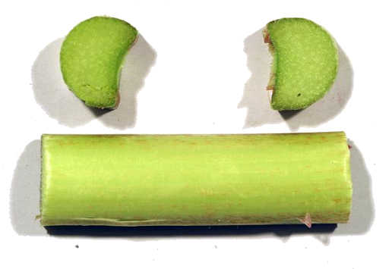






Crop breeding targets specific agricultural traits
Field trials in Horsham Australia for cold tolerance in chickpea (Cicer arietinum L.). CC-by D. Endresen
Rhubarb, Rheum x hybridum Murray, DKRHE43, by Gitte K. Bjørn
Powdery Mildew,
Blumeria graminis
Leaf spots
Ascochyta sp.
Yellow rust
Puccinia strilformis
Black stem rust
Puccinia graminis
Apple, Malus domestica Borkh.
Cultivar “Nanna” by Stein H Hjeltnes
Notes:
Fungus plant diseases, http://www.hgca.com/hgca/wde/diseases/
Apple, Malus domestica “Nanna” from Njøs in Norway by Stein Harald Hjeltnes, http://sesto.nordgen.org/sesto/index.php?scp=ngb&thm=pictures&mod=det&id=004019&img_size=768x512
Rhubarb, Rheum x hybridum Murray, DKRHE43, by Gitte K. Bjørn, http://sesto.nordgen.org/sesto/index.php?scp=ngb&thm=sesto&lev=acc&accide=28981&lst=img
Chickpea at Horsham in Australia, CC-by D Endresen, https://plus.google.com/photos/+DagEndresen/albums/5323049422958990705/5365279366656917090?banner=pwa&pid=5365279366656917090&oid=115547050550954466285

Slide 35

Challenges for utilization of plant genetic resources * Large gene bank collections * Limited screening capacity
Field of sugar beet (Beta vulgaris L.) at Alnarp (June 2005) CC-BY Dag Endresen.
Notes:
Photo: Dag Endresen. Field of sugar beet (Beta vulgaris L.) at Alnarp (June 2005). URL: http://www.flickr.com/photos/dag_endresen/4189812241/

Slide 36

A needle in a hay stack
Scientists and plant breeders want a few hundred germplasm accessions to evaluate for a particular trait.
How does the scientist select a small subset likely to have the useful trait?
Photo from the USDA Photo archive, CC0.
Notes:
Photo from the USDA Photo archive. Slide text by Ken Street, ICARDA FIGS team (2009).

Slide 37

Aim:
Identification of plant germplasm with a higher likelihood of having desired genetic diversity for a target trait property.
Suggested solution:
Using environment data layers for predictive characterization of crop traits a priori BEFORE field trials.
Bread wheat at Nöbbelöv in Lund, 2010
CC-BY Dag Endresen
Notes:
Photo: Bread wheat (Triticum aestivum L.) at Nöbbelöv in Lund July 2010 by Dag Endresen. URL: http://www.flickr.com/photos/dag_endresen/4826565058/

Slide 38











Climate effect during the domestication process
Wild relatives are shaped
by the environment.
Primitive cultivated crops are shaped by local climate and humans.
Traditional cultivated crops (landraces) are shaped by climate and humans.
Modern cultivated crops are mostly shaped by humans (plant breeders).
Perhaps future crops are shaped in the molecular laboratory…?
Notes:
Modern agriculture uses advanced plant varieties based on the most productive genetics. The original land races and wild forms produce lower yields, but their greater genetic variation contains a higher diversity in e.g. resistance to disease. High-yielding modern crops are therefore vulnerable when a new disease arises.

Slide 39









Predictive link between eco-geography and traits
During traditional cultivation the farmer will select for and introduce germplasm for improved suitability of the landrace to the local conditions.
Notes:
Illustration traditional cattle farming: http://commons.wikimedia.org/wiki/File:Traditional_farming_Guinea.jpg (USAID, Public Domain)

Slide 40


Focused Identification of Germplasm Strategy
Mediterranean Sea
South Australia
Origin of Concept:
Boron toxicity in marine sediments for wheat and barley genetic resources - example of late 1980s.
Michael Mackay (1986, 1990, 1995)
Notes:
This slide was originally made by Michael Mackay around 1995.
We can then use these layers of information as sieves, through which we can filter our accessions to identify those most likely to contain the genetic variation we are seeking.
We can “tune in” the environments from which we want to sample germplasm.
For example, we can specify annual precipitation, temperature during heading, humidity at another growth stage - and so on.
Then we tip our collection of accessions in the top of the FIGS machine and wait for those that filter out the bottom. These ones we evaluate thoroughly.
References:
* Mackay, M.C. (1986). Utilizing wheat genetic resources in Australia. p. 56-61. In: McLean, R. (ed). Proceedings of the 5th assembly wheat breeders' society in Australia, Merredin 18-22 Aug 1986. Western Australian Department of Agriculture, Perth, Australia. 580 p. ISBN: 9780730913269.
* Mackay, M.C. (1990). Strategic planning for effective evaluation of plant germplasm. p. 21–25. In: J.P. Srivastava and A.B. Damania (eds). Wheat genetic resources: Meeting diverse needs. John Wiley & Sons, Chichester, UK. ISBN 0-471-92880-1
* Mackay, M.C. (1995). One core collection or many? p. 199-210. In: T. Hodgkin, A.H.D. Brown, Th.J.L. van Hintum and A.A.V. Morales (eds). Core collections of plant genetic resources. Proceedings from the IBPGR/CGN/CENARGEN workshop on 'Core Collections: Improving the Management and Use of Plant Germplasm Collections', held in Brasilia August 1992. John Wiley & Sons, Chichester, UK. 269 p. ISBN: 978-0-471-95545-0.
* Mackay, M.C. (2011). Surfing the genepool, the effective and efficient use of plant genetic resources. PhD thesis. Department of Plant Breeding and Biotechnology, Faculty of landscape planning, horticulture and agricultural science, Swedish University of Agricultural Sciences (SLU), Alnarp. ISBN: 978-91-576-7634-4. Available at http://pub.epsilon.slu.se/8439/, verified 9 Dec 2011.

Slide 41

Focused Identification of Germplasm strategy
Identify new and useful genetic diversity for crop improvement.
Heuristic experience and expert knowledge for finding upper and lower limits for environmental variables (1).
Predictive eco-geographic data modelling analysis (2).
http://www.figstraitmine.org/
http://figs.icarda.org/ConsultationWiki/
Notes:
“We can then use these layers of information as sieves, through which we can filter our accessions to identify those most likely to contain the genetic variation we are seeking. We can “tune in” the environments from which we want to sample germplasm. For example, we can specify annual precipitation, temperature during heading, humidity at another growth stage - and so on. Then we tip our collection of accessions in the top of the FIGS machine and wait for those that filter out the bottom. These ones we evaluate thoroughly” (Michael Mackay, 1995).
References: * Mackay, M.C. (1986). Utilizing wheat genetic resources in Australia. p. 56-61. In: McLean, R. (ed.). Proceedings of the 5th assembly wheat breeders' society in Australia, Merredin 18-22 Aug 1986. Western Australian Department of Agriculture, Perth, Australia. 580 p. ISBN: 9780730913269. * Mackay, M.C. (1990). Strategic planning for effective evaluation of plant germplasm. p. 21–25. In: J.P. Srivastava and A.B. Damania (eds). Wheat genetic resources: Meeting diverse needs. John Wiley & Sons, Chichester, UK. ISBN 0-471-92880-1. * Mackay, M.C. (1995). One core collection or many? p. 199-210. In: T. Hodgkin, A.H.D. Brown, Th.J.L. van Hintum and A.A.V. Morales (eds). Core collections of plant genetic resources. Proceedings from the IBPGR/CGN/CENARGEN workshop on 'Core Collections: Improving the Management and Use of Plant Germplasm Collections', held in Brasilia August 1992. John Wiley & Sons, Chichester, UK. 269 p. ISBN: 978-0-471-95545-0. * Mackay, M.C. (2011). Surfing the genepool, the effective and efficient use of plant genetic resources. PhD thesis. Department of Plant Breeding and Biotechnology, Faculty of landscape planning, horticulture and agricultural science, Swedish University of Agricultural Sciences (SLU), Alnarp. ISBN: 978-91-576-7634-4. Available at http://pub.epsilon.slu.se/8439/, verified 9 Dec 2011.
Wikipedia: Heuristic ( /hjʉˈrɪstɨk/; or heuristics; Greek: "Εὑρίσκω", "find" or "discover") refers to experience-based techniques for problem solving, learning, and discovery. Where an exhaustive search is impractical, heuristic methods are used to speed up the process of finding a satisfactory solution. Examples of this method include using a "rule of thumb", an educated guess, an intuitive judgment, or common sense. In more precise terms, heuristics are strategies using readily accessible, though loosely applicable, information to control problem solving in human beings and machines.

Slide 42



Climate data – WorldClim (v2 2016)
The climate data available from the WorldClim dataset (1 km² resolution)
http://www.worldclim.org/
(Hijmans et al. 2005 [v1];
Fick and Hijmans 2017 [v2])
Data from weather stations worldwide combined to a continuous surface layer.
Climate data for each landrace extracted from this surface layer.
Precipitation: 60 419 weather stations
Solar radiation: 9 118 weather stations
Notes:
Hijmans, R.J., S.E. Cameron, J.L. Parra, P.G. Jones and A. Jarvis (2005). Very high resolution interpolated climate surfaces for global land areas. International Journal of Climatology 25: 1965-1978. DOI: 10.1002/joc.1276
Total 20 590 weather stations with data for precipitation, and 7 280 with data for temperatures.
--
Fick, S.E. and R.J. Hijmans (2017). Worldclim 2: New 1-km spatial resolution climate surfaces for global land areas. International Journal of Climatology. DOI: 10.1002/joc.5086
New updated version issued 1st June 2016: http://worldclim.org/version2
Very high spatial resolution (approximately 1 km2), monthly temperature (minimum, maximum and average), precipitation, solar radiation, vapour pressure and wind speed, aggregated across a target temporal range of 1970–2000, using data from between 9000 and 60 000 weather stations.

Slide 43
WorldClim provides 19 BIOCLIM variables
Maximum temperature, minimum temperature, rainfall --->
BIO1 = Annual Mean Temperature BIO2 = Mean Diurnal Range (Mean of monthly (max temp - min temp)) BIO3 = Isothermality (BIO2/BIO7) (* 100) BIO4 = Temperature Seasonality (standard deviation *100) BIO5 = Max Temperature of Warmest Month BIO6 = Min Temperature of Coldest Month BIO7 = Temperature Annual Range (BIO5-BIO6) BIO8 = Mean Temperature of Wettest Quarter BIO9 = Mean Temperature of Driest Quarter BIO10 = Mean Temperature of Warmest Quarter BIO11 = Mean Temperature of Coldest Quarter BIO12 = Annual Precipitation BIO13 = Precipitation of Wettest Month BIO14 = Precipitation of Driest Month BIO15 = Precipitation Seasonality (Coefficient of Variation) BIO16 = Precipitation of Wettest Quarter BIO17 = Precipitation of Driest Quarter BIO18 = Precipitation of Warmest Quarter BIO19 = Precipitation of Coldest Quarter
Notes:
http://www.worldclim.org/bioclim

Slide 44

Limitations of FIGS
Landraces and wild relatives
The link between climate data and the trait data (local adaptation) is required for trait mining with FIGS. Modern cultivars are not expected to show this predictive link.
Georeferenced accessions
Trait mining with FIGS is based on multivariate models using climate data from the source location of the germplasm. To extract climate data the accessions need to be accurately georeferenced.
Wheat in the Hulah valley (Israel), 2007 by Aviad Bublil
Notes:
Photo: Wheat in the Hulah valley (Israel), 2007 by Aviad Bublil. License: Public Domain. http://commons.wikimedia.org/wiki/File:Wheat-haHula-ISRAEL2.JPG

Slide 45

Data analysis
Notes:
Data analysis

Slide 46

Steps to follow:
Data collection and preparation
Geo-referencing of collecting locations
Pre-processing of dataset
Choose modeling method
Calibration of model
Validation of model
Application of predictive model
(Validation of prediction results)
Thormann I, Parra-Quijano M, Endresen DTF, Rubio-Teso ML, Iriondo JM, and Maxted N (2014). Predictive characterization of crop wild relatives and landraces: Technical guidelines. Bioversity International, Rome, Italy.
Notes:
Thormann I, Parra-Quijano M, Endresen DTF, Rubio-Teso ML, Iriondo JM, and Maxted N (2014). Predictive characterization of crop wild relatives and landraces: Technical guidelines. Bioversity International, Rome, Italy.

Slide 47



Explore the dataset (for outliers)
The influence plot (residuals against leverage) shows sample NGB6300 separated from the “data cloud”.
After looking into the raw data, this observation point was removed as outlier (set to NaN).
Notes:
NGB6300 (accide 9039, FRO) observed at Priekuli, Latvia in 2003, replicate 2 is highlighted.
NGB776 (accide 8510, SWE) observed at Landskrona, Sweden in 2002 (both replicates) are highlighted. Replicate 2 (LYR312) largest residual, replicate 1 (LYR311) below.

Slide 48

Pre-processing
Mean centering removes the absolute intensity to avoid the model to focus on the variables with the highest numerical values (intensity).
Scaling makes the relative distribution of values (range spread) more equal between variables.
Auto-scaling is a combination of mean centering and variance scaling.
After auto-scaling all variables have a mean of zero and a standard deviation of one.
The objective is to help the model to separate the relevant information from the noise.
Notes:
Box-plot of the trait scores to illustrate the effect of the preprocessing. First row is no preprocessing; row 2 is mean-centering (centering across mode 1, samples); last row is auto-scale (centering across mode 1 and scaling across mode 2, traits).
Mean centering removes the absolute intensity information (the mean for each variable is subtracted from the individual data values). This pre-processing strategy is applied to avoid the model to focus on the variables with the highest numerical values (intensity).
Scaling: In general, scaling a variable in the data can be viewed as a multiplication of the corresponding column vector entries with some number. If the significances of the variables to the model are known prior to modeling, then it might be a good idea to upscale the highly relevant variables. In contrast, if a variable is supposed to bear merely noise, then its significance must be downscaled. However this is a rare case in reality. Therefore, unit-variance scaling (UV-scaling) is most often used. Moreover scaling itself is sometimes associated with UV-scaling. (Johann Gasteiger, and Dr. Thomas Engel (editors). 2003. Chemoinformatics: a textbook. Wiley-VCH, Weinheim. ISBN 9783527306817. Page 214)

Slide 49









pre-processing examples
No preprocessing
Mean centering
Auto scale
Priekuli
Bjørke
Landskrona
Notes:
Box-plot of the trait scores to illustrate the effect of the preprocessing. First row is no preprocessing; row 2 is mean-centering (centering across mode 1, samples); last row is auto-scale (centering across mode 1 and scaling across mode 2, traits).

Slide 50

A model of the real world
Validation of the model
No model can ever be absolutely correct.
A simulation model can only be an approximation.
A model is always created for a specific purpose.
Apply the model
The simulation model is applied to make predictions based on new fresh data.
Be aware to avoid extrapolation problems.

Slide 51


Data for the Trait Mining model
Training set
For the initial calibration / training.
Calibration set
For calibration and tuning.
Often cross-validation on the training set is used to reduce the consumption of raw data.
Test set
For the model validation / testing.
Data not used in the model calibration.
The best would of course be an independent test set!
Notes:
We often divide the data for a simulation model project in three equal parts: one set for initial model calibration or training, one set for further calibration or fine tuning; and one test set for validation on the model.

Slide 52

Modeling methods

Slide 53

Choosing modeling method “There is no silver bullet” (Qiao, Soberon and Peterson, 2015)
Choosing the appropriate data modeling method depend on the types of data quality issues you discover in your respective data set.
Some modeling methods are more sensitive to some types of data quality issues and less sensitive to other issues.
Different modeling methods or algorithms handle different types of data quality issues differently.
It is a bad strategy to simply choose the same method that performed well in your previous studies.
"Ensembles" can combine the qualities of multiple algorithms.
Notes:
Photo: Wheat field at Nöbbelöv, Lund Sweden July 2010, by Dag Endresen.
Qiao, H., Soberón, J. and Peterson, A. T. (2015), No silver bullets in correlative ecological niche modelling: insights from testing among many potential algorithms for niche estimation. Methods Ecol Evol, 6: 1126–1136. doi:10.1111/2041-210X.12397

Slide 54
Some data modeling methods
Parallel Factor Analysis (PARAFAC) (Multi-way)
Multi-linear Partial Least Squares (N-PLS) (Multi-way)
Soft Independent Modeling of Class Analogy (SIMCA)
k-Nearest Neighbor (kNN)
Partial Least Squares Discriminant Analysis (PLS-DA)
Linear Discriminant Analysis (LDA)
Principal component logistic regression (PCLR)
Generalized Partial Least Squares (GPLS)
Random Forests (RF)
Neural Networks (NN)
Support Vector Machines (SVM)
Boosted Regression Trees (BRT)
Multivariate Regression Trees (MRT)
Bayesian Regression Trees
Modeling methods used by Endresen (2010), Endresen et al. (2011, 2012), and Bari et al. (2012, 2016).
Notes:
Photo: Wheat field at Nöbbelöv in Lund, Sweden, July 2010, by Dag Endresen.

Slide 55




Validate: - Model performance - Model results

Slide 56

Validation of model results
Pearson product-moment correlation (R)
Coefficient of determination (R²)
Cohen’s Kappa (K)
Proportion observed agreement (PO)
Proportion positive agreement (PA)
Positive predictive value (PPV)
Positive diagnostic likelihood ratio (LR+)
Sensitivity and specificity
Area under the curve (AUC)
Receiver operating characteristics (ROC)
Root mean square error (RMSE)
RMSE of calibration (RMSEC)
RMSE of cross-validation (RMSECV)
RMSE of prediction (RMSEP)
Predicted residual sum of squares (PRESS)
Notes:
Photo CC-by Dag Endresen

Slide 57

Prediction performance
Model performance indicators that work better for unbalanced class / skew prevalence – which is common for evaluation data.
Positive predictive value (PPV)
PPV = True positives / (True positives + False positives)
Classification performance for the identification of resistant samples (for the positives only)
Positive diagnostic likelihood ratio (LR+)
LR+ = sensitivity / (1 – specificity)
Less sensitive to prevalence than PPV
Notes:
Photo: South of Tunisia, by Dag Endresen, http://www.flickr.com/photos/dag_endresen/4221301525/

Slide 58
Confusion matrix
 |  | Predicted
 |  | Positive (1) | Negative (0)
Observed (Actual) | Positive (1) | True positive (TP) | False negative (FN)
 | Negative (0) | False positive (FP) | True negative (TN)
PO = (TP + TN) / N
PA = (2 * TP) / (2 * TP + FP + FN)
PPV = TP / (TP + FP)
Sensitivity =TP / (TP + FN)
Specificity =TN / (TN + FP)
LR+ = Sensitivity / (1 – specificity) = (TP / [TP + FN]) / (FP / [FP + TN])
Yule’s Q = (OR - 1) / (OR + 1)
OR = (TP * TN) / (FN * FP)
Notes:
Cohen’s Kappa (K)
Proportion observed agreement (PO)
Proportion positive agreement (PA)
Positive predictive value (PPV)
Positive diagnostic likelihood ratio (LR+)
Sensitivity and specificity

Slide 59







Residuals (validate model fit)
The distance between the model (predictions) and the reference values (validation) is the residuals.
Example of a bad model calibration
Calibration step
Cross-validation indicates the appropriate model complexity.
Be aware of over-fitting! NB! Model validation!
59
Notes:
Residuals

Slide 60
Significance levels
Often the critical levels (α) for the p-value significance is set as 0.05, 0.01 and 0.001 (5 %, 1 %, 0.1 %).
5% (even a random effect when an experiment is repeated 20 times is likely to be observed one time).
1% (if an experiment is repeated 100 times a random effect is likely to be observed one time).
0.1% (if an experiment is repeated 1000 times a random effect is likely to be observed one time).
Notes:
http://en.wikipedia.org/wiki/Correlation, http://en.wikipedia.org/wiki/Coefficient_of_determination, http://en.wikipedia.org/wiki/Statistical_model_validation
Table of critical values for r: http://www.runet.edu/~jaspelme/statsbook/Chapter%20files/Table_of_Critical_Values_for_r.pdf
Table of critical values for r: http://www.gifted.uconn.edu/siegle/research/Correlation/corrchrt.htm
Table of critical values for r: http://www.jeremymiles.co.uk/misc/tables/pearson.html

Slide 61

Area under the ROC (AUC)

Slide 62

Examples of "FIGS" studies

Slide 63

Example of studies:
Heuristic approach:
Sunn pest on wheat (Bouhssini et al. 2009)
Powdery mildew, Pm3 (Bhullar et al. 2009)
Russian wheat aphid (Bouhssini et al. 2011)
Multi-way approach:
Morphological traits Nordic Barley landraces (Endresen 2010)
Multivariate approach:
Net blotch on barley landraces (Endresen et al. 2011)
Stem rust on wheat landraces (Endresen et al. 2011)
Stem rust on wheat landraces (Bari et al. 2012)
Ug99 stem rust on wheat (Endresen et al. 2012)
Faba bean drought tolerance (Khazaei et al. 2013a, 2013b)
Stripe (yellow) rust on wheat (Bari et al. 2014)
Faba bean drought adaptation (Bari et al. 2016)
Crop wild relatives:
Technical guidelines (Thormann et al. 2014)
Avena CWR (Thormann et al. 2015)
Salix Accessions at Alnarp, 2011 by Dag Endresen, CC-By
Notes:
Photo: Salix Accessions at Alnarp, 2011 by Dag Endresen, https://picasaweb.google.com/lh/photo/ub14FvkbCURoZp3WMkdd-tMTjNZETYmyPJy0liipFm0?feat=directlink
References:
* Bouhssini, M., Street, K., Joubi, A., Ibrahim, Z., Rihawi, F. (2009). Sources of wheat resistance to Sunn pest, Eurygaster integriceps Puton, in Syria. Genetic Resources and Crop Evolution. DOI: 10.1007/s10722-009-9427-1
* Bhullar, N.K., K. Street, M. Mackay, N. Yahiaoui, and B. Keller (2009). Unlocking wheat genetic resources for the molecular identification of previously undescribed functional alleles at the Pm3 resistance locus. PNAS 106(23):9519-9524. DOI: 10.1073/pnas.0904152106
* Bouhssini M El, Street K, Amri A, Mackay M, Ogbonnaya FC, Omran A, Abdalla O, Baum M, Dabbous A, and Rihawi F (2011). Sources of resistance in bread wheat to Russian wheat aphid (Diuraphis noxia) in Syria identified using the focused identification of germplasm strategy (FIGS). Plant breeding 130: 96-97. DOI: 10.1111/j.1439-0523.2010.01814.x
* Endresen, D.T.F. (2010). Predictive association between trait data and ecogeographic data for Nordic barley landraces. Crop Science 50: 2418-2430. DOI: 10.2135/cropsci2010.03.0174
* Endresen, D.T.F., K. Street, M. Mackay, A. Bari, E. De Pauw (2011). Predictive association between biotic stress traits and ecogeographic data for wheat and barley landraces. Crop Science 51: 2036-2055. DOI: 10.2135/cropsci2010.12.0717
* Bari, A., K. Street, , M. Mackay, D.T.F. Endresen, E. De Pauw, and A. Amri (2012). Focused Identification of Germplasm Strategy (FIGS) detects wheat stem rust resistance linked to environment variables. Genetic Resources and Crop Evolution 59:1465-1481. doi:10.1007/s10722-011-9775-5
* Endresen, D.T.F., K. Street, M. Mackay, A. Bari, E. De Pauw, K. Nazari, and A. Yahyaoui (2012). Sources of Resistance to Stem Rust (Ug99) in Bread Wheat and Durum Wheat Identified Using Focused Identification of Germplasm Strategy (FIGS). Crop Science 52:764-773. doi: 10.2135/cropsci2011.08.0427; Published online 8 Dec 2011.
* Khazaei H, Street K, Santanen A, Bari A, Stoddard FL (2013a). Do faba bean (Vicia faba L.) accessions from environments with contrasting seasonal moisture availabilities differ in stomatal characteristics and related traits? Genetic Resources and Crop Evolution 60: 2343-2357. DOI: 10.1007/s10722-013-0002-4
* Khazaei H, Street K, Bari A, Mackay M, Stoddard FL (2013b). The FIGS (Focused Identification of Germplasm Strategy) Approach Identifies Traits Related to Drought Adaptation in Vicia faba Genetic Resources. PLoS ONE 8(5): e63107. doi:10.1371/journal.pone.0063107
* Bari A, Amri A, Street K, Mackay M, De Pauw E, Sanders R, Nazari K, Humeid B, Konopka J, & Alo F (2014). Predicting resistance to stripe (yellow) rust (Puccinia striiformis) in wheat genetic resources using focused identification of germplasm strategy. The Journal of Agricultural Sciences 152(6): 906-916. doi:10.1017/S0021859613000543 ISSN: 0021-8596.
* Bari, A., Khazaei, H., Stoddard, F.L., Street K., Sillanpää MJ, Chaubey YP, Dayanandan S, Endresen DTF, De Pauw E, Damania AB (2016) Climatic Change 134: 667. doi:10.1007/s10584-015-1541-9
* Thormann I, Parra-Quijano M, Endresen DTF, Rubio-Teso ML, Iriondo JM, and Maxted N (2014). Predictive characterization of crop wild relatives and landraces: Technical guidelines. Bioversity International, Rome, Italy.
* Thormann I, Parra Quijano M, Iriondo JM, Rubio Teso ML, Endresen DT, Maxted N, Dias S, and Dulloo ME (2015) Two predictive characterization approaches to search for target traits in crop wild relatives and landraces. Crop Wild Relative 10: 16-18.

Slide 64



Sunn pest on wheat (Heuristic FIGS approach 2009)
No previous sources of Sunn pest resistance had been found in hexaploid wheat.
2 000 accessions were screened at ICARDA without results during 2000 to 2006.
No resistant accessions found.
A FIGS set of 534 accessions was developed and screened in 2007 and 2008.
Starting with 16 000 wheat landraces from VIR, ICARDA and AWCC.
Excluding origin CHN, PAK, IND - were Sunn pest was only recently reported (6 328 accessions).
One accession per collecting site (2 830 accessions).
Excluding dry environments below 280 mm/year.
Excluding sites of low winter temperature below 10 degrees Celsius (1 502 accessions).
Reduced to 534 accessions, using PCA clustering.
10 new resistant accessions were found!
Bouhssini, M., K. Street, A. Joubi, Z. Ibrahim, and F. Rihawi (2009). Sources of wheat resistance to Sunn pest, Eurygaster integriceps Puton, in Syria. Genetic Resources and Crop Evolution 56:1065-1069. doi:10.1007/s10722-009-9427-1
Based on a slide by Ken Street, ICARDA
Notes:
* Bouhssini, M., Street, K., Joubi, A., Ibrahim, Z., Rihawi, F. (2009). Sources of wheat resistance to Sunn pest, Eurygaster integriceps Puton, in Syria. Genetic Resources and Crop Evolution. URL http://dx.doi.org/10.1007/s10722-009-9427-1, http://www.springerlink.com/content/587250g7qr073636/ (Recent FIGS study at ICARDA, Syria.)

Slide 65


Powdery mildew on wheat (Heuristic FIGS approach 2009)
A powdery mildew resistance set was derived based on the environmental conditions for PM hotspots.
Starting with 16,089 wheat landraces (6159 sites).
FIGS subset of 1320 wheat accessions (420 sites).
211 accessions were scored as resistant in the field trials.
Only 7 resistance alleles (Pm3a to Pm3g) were previously known at the Pm3 locus.
7 new resistance alleles (Pm3h to Pm3n) were found in this study.
Bhullar, N.K., K. Street, M. Mackay, N. Yahiaoui, and B. Keller (2009). Unlocking wheat genetic resources for the molecular identification of previously undescribed functional alleles at the Pm3 resistance locus. PNAS 106(23):9519-9524. doi:10.1073/pnas.0904152106
Powdery mildew on wheat. Bhullar et al (2009) PNAS 106: 9519-9524, Fig 2.
Notes:
Photo: Bhullar et al (2009). PNAS 106:9519-9524, Figure 2.
Bhullar, N.K., K. Street, M. Mackay, N. Yahiaoui, and B. Keller (2009). Unlocking wheat genetic resources for the molecular identification of previously undescribed functional alleles at the Pm3 resistance locus. PNAS 106(23):9519-9524. DOI: 10.1073/pnas.0904152106. http://www.pnas.org/content/106/23/9519.full
Wikipedia: Heuristic ( /hjʉˈrɪstɨk/; or heuristics; Greek: "Εὑρίσκω", "find" or "discover") refers to experience-based techniques for problem solving, learning, and discovery. Where an exhaustive search is impractical, heuristic methods are used to speed up the process of finding a satisfactory solution. Examples of this method include using a "rule of thumb", an educated guess, an intuitive judgment, or common sense. In more precise terms, heuristics are strategies using readily accessible, though loosely applicable, information to control problem solving in human beings and machines.

Slide 66






Morphological traits in Nordic Barley landraces
Endresen, D.T.F. (2010). Predictive association between trait data and ecogeographic data for Nordic barley landraces. Crop Science 50: 2418-2430. DOI: 10.2135/cropsci2010.03.0174
Field observations by Agnese Kolodinska Brantestam (2002 to 2003)
Multi-way N-PLS data analysis
Bjørke (NOR)
Landskrona (SWE)
Priekuli (LVA)
Notes:
The barley trait dataset was developed by Kolodinska Brantestam (2005) and published as part of her doctoral thesis. The field trials were performed in two replications during 2 yr (2002 and 2003), at three locations (Bjørke in southern Norway, Landskrona in southern Sweden, and Priekuļi in Latvia). Six agronomic traits were scored: days to heading (from 1 June), days to maturity (from 1 July), plant height (cm), harvest index (percent), volumetric weight (kg/hl) and thousand-grain weight (gram).
--
Kolodinska Brantestam, Agnese (2005). A century of breeding - is genetic erosion a reality? [PhD Doctoral thesis]. Sveriges lantbruksuniv. [Swedish Agricultural University] (SLU), Alnarp. Acta Universitatis agriculturae Sueciae, 1652-6880 ; 2005:30. ISBN 91-576-7029-3. Available at http://pub.epsilon.slu.se/797/
--
Endresen, D.T.F. (2010). Predictive association between trait data and eco-geographic data for Nordic barley landraces. Crop Science 50: 2418-2430. DOI: 10.2135/cropsci2010.03.0174
--
Nordic barley landraces included in this study: NGB27 NGB456 NGB468 NGB469 NGB775 NGB776 NGB792 NGB2072 NGB2565 NGB4641 NGB4701 NGB6300 NGB9529 NGB13458
--
Accession no. Locality and country of origin Elevation Latitude Longitude
NGB27 Sarkalahti, Luumäki, Finland 95 61.033 27.333
NGB456 Dønna, Nordland, Norway 71 66.117 12.500
NGB468 Trysil, Norway 400 61.283 12.283
NGB469 Bjørneby, Norway 400 61.283 12.283
NGB775 Överkalix, Allsån, Sweden† 45 66.400 22.933
NGB776 Överkalix, Sweden 100 66.400 22.767
NGB792 Luusua, Kemijärvi, Finland 145 66.483 27.350
NGB2072 Finset, Norway 1220 60.600 7.500
NGB2565 Öland, Sweden 11 56.733 16.667
NGB4641 Støvring, Jylland, Denmark 55 56.883 9.833
NGB4701 Faroe Islands 81 62.017 −6.767
NGB6300 Faroe Islands 81 62.017 −6.767
NGB9529 Lyderupgaard, Denmark 9 56.567 9.350
NGB13458 Koskenkylä, Rovaniemi, Finland 91 66.517 25.867
--
NGB27, http://sesto.nordgen.org/sesto/index.php?scp=ngb&thm=sesto&accnumtxt=27
NGB456, http://sesto.nordgen.org/sesto/index.php?scp=ngb&thm=sesto&accnumtxt=456
NGB468, http://sesto.nordgen.org/sesto/index.php?scp=ngb&thm=sesto&accnumtxt=468
NGB469, http://sesto.nordgen.org/sesto/index.php?scp=ngb&thm=sesto&accnumtxt=469
NGB775, http://sesto.nordgen.org/sesto/index.php?scp=ngb&thm=sesto&accnumtxt=775
NGB776, http://sesto.nordgen.org/sesto/index.php?scp=ngb&thm=sesto&accnumtxt=776
NGB792, http://sesto.nordgen.org/sesto/index.php?scp=ngb&thm=sesto&accnumtxt=792
NGB2072, http://sesto.nordgen.org/sesto/index.php?scp=ngb&thm=sesto&accnumtxt=2072
NGB2565, http://sesto.nordgen.org/sesto/index.php?scp=ngb&thm=sesto&accnumtxt=2565
NGB4641, http://sesto.nordgen.org/sesto/index.php?scp=ngb&thm=sesto&accnumtxt=4641
NGB4701, http://sesto.nordgen.org/sesto/index.php?scp=ngb&thm=sesto&accnumtxt=4701
NGB6300, http://sesto.nordgen.org/sesto/index.php?scp=ngb&thm=sesto&accnumtxt=6300
NGB9529, http://sesto.nordgen.org/sesto/index.php?scp=ngb&thm=sesto&accnumtxt=9529
NGB13458, http://sesto.nordgen.org/sesto/index.php?scp=ngb&thm=sesto&accnumtxt=13458
--

Slide 67
Multi-way data structure (N-PLS)
36 variables
Min. temperature
Max. temperature
Precipitation
Jan, Feb, Mar, …
(mode 2)
Jan, Feb, Mar, …
(mode 2)
Jan, Feb, Mar, …
(mode 2)
mode 1
14 samples
1st level for mode 3
2nd level for mode 3
3rd level for mode 3
Precipitation
Max temp
(mode 3)
3 climate variables
Min temp
14 samples (mode 1)
14 samples (mode 1)
12 months (mode 2)
12 months (mode 2)

Slide 68
Multi-way N-PLS results: Nordic barley landraces
Experiment Site Year |  | Heading days | Ripening days | Length of plant | Harvest index | Volumetric weight | Thousand grain weight³
LVA | 2002¹ | n.s. | n.s. | n.s. | n.s. | *** | n.s.
LVA | 2003 | *** | n.s. | ** | ** | *** | n.s.
NOR | 2002 | - | * | ** | *** | ** | n.s.
NOR | 2003 | ** | *** | *** | * | * | n.s.
SWE | 2002 | ** | *** | n.s. | ** | * | n.s.
SWE | 2003² | n.s. | ** | n.s. | n.s. | ** | n.s.
*** | Significant at the 0.001 level (p-value)
** | Significant at the 0.01 level
* | Significant at the 0.05 level
n.s. | Not significant (at the above levels)
¹ LVA 2002 | Germination on spikes (very wet June)
² SWE 2003 | Incomplete grain filling (very dry June)
³ The thousand grain weight was not predicted well.
Endresen, D.T.F. (2010). Predictive association between trait data and ecogeographic data for Nordic barley landraces. Crop Science 50: 2418-2430. doi:10.2135/cropsci2010.03.0174
Notes:
Endresen, D.T.F. (2010). Predictive association between trait data and eco-geographic data for Nordic barley landraces. Crop Science 50: 2418-2430. DOI: 10.2135/cropsci2010.03.0174

Slide 69


Net blotch on barley landraces
Green dots indicate collecting sites for resistant wheat landraces and red dots collecting sites for susceptible landraces.
Field experiments made in Minnesota, North Dakota and Georgia in the USA.
USDA GRIN, trait data online:
http://www.ars-grin.gov/cgi-bin/npgs/html/desc.pl?1041
Notes:
GRIN database (USDA-ARS, National Plant Germplasm System, Germplasm Resources Information Network, online http://www.ars-grin.gov/npgs)
USDA GRIN, trait data online: http://www.ars-grin.gov/cgi-bin/npgs/html/desc.pl?1041
Dr Harold Bockelman extracted the trait data (C&E)

Slide 70
Multivariate SIMCA results: Net blotch on barley
Dataset (unit) | PPV | LR+ | Estimated gain
Net blotch (accession) | 0.54 (0.48-0.60) | 1.75 (1.42-2.17) | 1.35 (1.19-1.50)
Random | 0.40 (0.35-0.45) | 0.99 (0.84-1.17) | 0.99 (0.87-1.12)
(prevalence 40 % resistant samples)
PPV = Positive Predictive Value; LR+ = Positive Diagnostic Likelihood Ratio
Endresen, D.T.F., K. Street, M. Mackay, A. Bari, & E. De Pauw (2011). Predictive association between biotic stress traits and ecogeographic data for wheat and barley landraces. Crop Science 51: 2036-2055. doi:10.2135/cropsci2010.12.0717
Notes:
Endresen, D.T.F., K. Street, M. Mackay, A. Bari, E. De Pauw (2011). Predictive association between biotic stress traits and ecogeographic data for wheat and barley landraces. Crop Science 51: 2036-2055. DOI: 10.2135/cropsci2010.12.0717

Slide 71

SIMCA analysis (PCA model for each class)
Example from the stem rust set:
Principal component 3
2 PCs
3 PCs
Principal component 1
 | Resistant samples
 | Intermediate
 | Susceptible
1 PC
*
Principal component 2
Illustration modified from Wise et al., 2006:201 (PLS Toolbox software manual)
Notes:
Left side illustration is modified from Wise et al., 2006:201 (PLS Toolbox software manual). The right side illustration is made by the PLS Toolbox software in MATLAB.

Slide 72



Stem rust on wheat landraces
Green dots indicate collecting sites for resistant wheat landraces and red dots collecting sites for susceptible landraces.
USDA trait data: www.ars-grin.gov/cgi-bin/npgs/html/desc.pl?65049
Field experiments were made in Minnesota by Don McVey
Notes:
GRIN database (USDA-ARS, National Plant Germplasm System, Germplasm Resources Information Network, online http://www.ars-grin.gov/npgs)
USDA GRIN, trait data online: http://www.ars-grin.gov/cgi-bin/npgs/html/desc.pl?65049
Endresen, D.T.F., K. Street, M. Mackay, A. Bari, E. De Pauw (2011). Predictive association between biotic stress traits and ecogeographic data for wheat and barley landraces. Crop Science 51: 2036-2055. DOI: 10.2135/cropsci2010.12.0717
Bari, A., K. Street, , M. Mackay, D.T.F. Endresen, E. De Pauw, and A. Amri (2012). Focused Identification of Germplasm Strategy (FIGS) detects wheat stem rust resistance linked to environment variables. Genetic Resources and Crop Evolution 59(7):1465-1481. DOI:10.1007/s10722-011-9775-5

Slide 73

Multivariate SIMCA results: Stem rust on wheat
SIMCA classification | PPV | LR+ | Estimated gain
Stem rust (site) | 0.50 (0.40-0.60) | 4.00 (2.85-5.66) | 2.51 (2.02-2.98)
Random | 0.19 (0.13-0.26) | 0.94 (0.63-1.39) | 0.95 (0.66-1.33)
(prevalence 20 % resistant samples)
PPV = Positive Predictive Value; LR+ = Positive Diagnostic Likelihood Ratio
Endresen, D.T.F., K. Street, M. Mackay, A. Bari, & E. De Pauw (2011). Predictive association between biotic stress traits and ecogeographic data for wheat and barley landraces. Crop Science 51: 2036-2055. doi:10.2135/cropsci2010.12.0717
Photo: USDA ARS Image k1192-1
Notes:
Photo: USDA ARS Image k1192-1, http://www.ars.usda.gov/is/graphics/photos/mar09/k11192-1.htm
Endresen, D.T.F., K. Street, M. Mackay, A. Bari, E. De Pauw (2011). Predictive association between biotic stress traits and ecogeographic data for wheat and barley landraces. Crop Science 51: 2036-2055. DOI: 10.2135/cropsci2010.12.0717
Bari, A., K. Street, , M. Mackay, D.T.F. Endresen, E. De Pauw, and A. Amri (2012). Focused Identification of Germplasm Strategy (FIGS) detects wheat stem rust resistance linked to environment variables. Genetic Resources and Crop Evolution 59(7):1465-1481. DOI:10.1007/s10722-011-9775-5

Slide 74


Multivariate results: Stem rust on wheat
Abdallah Bari
Scientist ICARDA
Classifier method | AUC | Cohen’s Kappa
Principal Component Regression (PCR) | 0.69 (0.68-0.70) | 0.40 (0.37-0.42)
Partial Least Squares (PLS) | 0.69 (0.68-0.70) | 0.41 (0.39-0.43)
Random Forest (RF) | 0.70 (0.69-0.71) | 0.42 (0.40-0.44)
Support Vector Machines (SVM) | 0.71 (0.70-0.72) | 0.44 (0.42-0.45)
Artificial Neural Networks (ANN) | 0.71 (0.70-0.72) | 0.44 (0.42-0.46)
AUC = Area Under the ROC Curve (ROC, Receiver Operating Curve)
Bari, A., K. Street, , M. Mackay, D.T.F. Endresen, E. De Pauw, & A. Amri (2012). Focused Identification of Germplasm Strategy (FIGS) detects wheat stem rust resistance linked to environment variables. Genetic Resources and Crop Evolution 59(7):1465-1481. doi:10.1007/s10722-011-9775-5
Photo Ug99 stem rust on wheat, by Petr Kosina/CIMMYT
Notes:
Photo Ug99 stem rust on wheat, by Petr Kosina/CIMMYT, CC-by-nc-sa, http://www.flickr.com/photos/cimmyt/5447282461/

Slide 75


Stem rust (Ug99) on wheat
Ug99 set with 4563 wheat landraces screened for Ug99 in Yemen in 2007, with prevalence of 10.2 % resistant accessions. True trait scores were reported for 20% of the accessions (825 samples) as training set. We then used SIMCA to select 500 accessions more likely to be resistant from the remaining 3728 accessions (with the true trait scores in the larger set of 3728 accessions hidden to the person making the analysis). This set of 500 accessions held 25.8 % resistant samples and thus 2.3 times higher than expected by chance.
Endresen, D.T.F., K. Street, M. Mackay, A. Bari, E. De Pauw, K. Nazari, & A. Yahyaoui (2012). Sources of Resistance to Stem Rust (Ug99) in Bread Wheat and Durum Wheat Identified Using Focused Identification of Germplasm Strategy (FIGS). Crop Science 52(2):764-773. doi:10.2135/cropsci2011.08.0427
Notes:
Endresen, D.T.F., K. Street, M. Mackay, A. Bari, E. De Pauw, K. Nazari, and A. Yahyaoui (2012). Sources of Resistance to Stem Rust (Ug99) in Bread Wheat and Durum Wheat Identified Using Focused Identification of Germplasm Strategy (FIGS). Crop Science [online first]. doi: 10.2135/cropsci2011.08.0427; Published online 8 Dec 2011.

Slide 76

Multivariate results: Stem rust (Ug99) on wheat
Classifier method | PPV | LR+ | Estimated gain
Pre-study, training set 550 accessions – validation test set 275 accessions
kNN (pre-study) | 0.29 (0.13-0.53) | 5.61 (2.21-14.28) | 4.14 (1.86-7.57)
SIMCA | 0.28 (0.14-0.48) | 5.26 (2.51-11.01) | 4.00 (2.00-6.86)
Ensemble classifier | 0.33 (0.12-0.65) | 8.09 (2.23-29.42) | 6.47 (2.05-11.06)
Random | 0.06 (0.01-0.27) | 0.95 (0.13-6.73) | 0.97 (0.16-4.35)
Blind study, training set 825 – blind validation test set 3738 accessions
Ensemble classifier | 0.26 (0.22-0.30) | 2.78 (2.34-3.31) | 2.32 (2.00-2.68)
Random | 0.11 (0.09-0.15) | 1.02 (0.77-1.36) | 0.95 (0.77-1.32)
PPV = Positive Predictive Value; LR+ = Positive Diagnostic Likelihood Ratio
Endresen, D.T.F., K. Street, M. Mackay, A. Bari, E. De Pauw, K. Nazari, & A. Yahyaoui (2012). Sources of Resistance to Stem Rust (Ug99) in Bread Wheat and Durum Wheat Identified Using Focused Identification of Germplasm Strategy (FIGS). Crop Science 52(2):764-773. doi:10.2135/cropsci2011.08.0427
Ug99 rust resistance trials on wheat at Njoro, Kenya. By Petr Kosina/CIMMYT, CC-by-sa-nc.
Notes:
Illustration: Young winter wheat plants in a growth chamber at Njoro Agricultural Research Station in Kenya, part of international trials for screening for resistance to Ug99, the new and virulent strain of stem rust that emerged in Uganda in 1999. Photo by Petr Kosina/CIMMYT, cc-by-nc-sa, http://www.flickr.com/photos/cimmyt/4809044405/

Slide 77

Try yourself!
Documented R-scripts, test data, and step-wise instructions.
Thormann I, Parra-Quijano M, Endresen DTF, Rubio-Teso ML, Iriondo JM & Maxted N. (2014) Predictive characterization of crop wild relatives and landraces: Technical guidelines version 1.Bioversity International, Rome, Italy. 44 pp. ISBN: 978-92-9255-004-2.
doi:10.13140/RG.2.1.1359.0487
https://www.duo.uio.no/handle/10852/41681
Notes:
Guidelines for conducting predictive characterization. Documented R-scripts and easy to follow instructions.
--
Thormann I, Parra-Quijano M, Endresen DTF, Rubio-Teso ML, Iriondo JM & Maxted N (2014). Predictive characterization of crop wild relatives and landraces: Technical guidelines version 1.Bioversity International, Rome, Italy. 44 pp. ISBN: ISBN 978-92-9255-004-2.

Slide 78
References, DM on genes
Food security
FAO, IFAD and WFP. 2014. The State of Food Insecurity in the World 2014. Strengthening the enabling environment for food security and nutrition. Rome, FAO. ISBN: 978-92-5-108543-1. http://www.fao.org/publications/sofi/2014/en/, http://www.fao.org/3/a-i4030e.pdf
FAO (2011). Looking ahead in world food and agriculture: Perspectives to 2050. Edited by Piero Conforti. FAO, Economic and Social Development Department, Rome. ISBN 978-92-5-106903-5.
William R. Cline (2007). Global Warming and Agriculture: Impacts estimated by country. Washington: Center for Global Development and
Peterson Institute for International Economics. ISBN 978-0-88132-403-7. http://bookstore.piie.com/book-store/4037.html, http://www.google.se/books?id=CwIQ-9YdjzQC
William R. Cline (2008). Global Warming and Agriculture. Finance and Development March 2008. https://www.imf.org/external/pubs/ft/fandd/2008/03/pdf/cline.pdf
David B. Lobell, Marshall B. Burke, Claudia Tebaldi, Michael D. Mastrandrea, Walter P. Falcon, and Rosamond L. Naylor (2008). Prioritizing Climate Change Adaptation Needs for Food Security in 2030. Science 1 February 2008: 319 (5863), 607-610. [DOI:10.1126/science.1152339]
GRID Arendal (2008). Projected agriculture in 2080 due to climate change. http://www.grida.no/graphicslib/detail/projected-agriculture-in-2080-due-to-climate-change_15f0
Intergovernmental Panel on Climate Change (IPCC) (2014). The Fifth Assessment Report (AR5). WG II: Impacts, Adaptation and Vulnerability – 31 March 2014.
http://www.ipcc.ch/report/ar5/index.shtml
IPCC AR5 (2014). Chapter 7. Food Security and Food production systems, http://ipcc-wg2.gov/AR5/images/uploads/WGIIAR5-Chap7_FGDall.pdf
Crop Wild Relatives
Maxted N, and Kell S (2009). Establishment of a Global Network for the In Situ Conservation of Crop Wild Relatives: Status and Needs. FAO, Rome.
http://www.fao.org/docrep/013/i1500e/i1500e18a.pdf
Asdal, Å, Philips, J., Maxted, N. (2013). Boost for crop wild relative conservation in Norway. Crop Wild Relative 9: 20-21. ISSN 1742-3694. http://www.pgrsecure.bham.ac.uk/sites/default/files/documents/newsletters/CWR_Issue_9.pdf
GBIF and agrobiodiversity
GBIF (2016) Final Report of the Task Group on GBIF Data Fitness for Use in Agrobiodiversity. Task group members: Arnaud E, Castaneda-Alvarez, NP Cossi JG, Endresen D, Jahanshiri E, and Vigouroux Y. Global Biodiversity Information Facility (GBIF), Copenhagen, and Bioversity International, Rome. Available at http://www.gbif.org/resource/82283
Predictive characterization
Bouhssini M, Street K, Joubi A, Ibrahim Z, and Rihawi F (2009). Sources of wheat resistance to Sunn pest, Eurygaster integriceps Puton, in Syria. Genetic Resources and Crop Evolution 56:1065-1069. doi:10.1007/s10722-009-9427-1
Bhullar NK, Street K, Mackay M, Yahiaoui N, and Keller B (2009). Unlocking wheat genetic resources for the molecular identification of previously undescribed functional alleles at the Pm3 resistance locus. PNAS 106(23):9519-9524. doi:10.1073/pnas.0904152106
Endresen DTF (2010). Predictive association between trait data and ecogeographic data for Nordic barley landraces. Crop Science 50: 2418-2430. doi:10.2135/cropsci2010.03.0174
Endresen DTF, Street K, Mackay M, Bari A, & De Pauw E (2011). Predictive association between biotic stress traits and ecogeographic data for wheat and barley landraces. Crop Science 51: 2036-2055. doi:10.2135/cropsci2010.12.0717
Bari A, Street K, Mackay M, Endresen DTF, De Pauw E, & Amri A (2012). Focused Identification of Germplasm Strategy (FIGS) detects wheat stem rust resistance linked to environment variables. Genetic Resources and Crop Evolution 59(7):1465-1481. doi:10.1007/s10722-011-9775-5
Endresen DTF, Street K, Mackay M, Bari A, De Pauw E, Nazari K, & Yahyaoui A (2012). Sources of Resistance to Stem Rust (Ug99) in Bread Wheat and Durum Wheat Identified Using Focused Identification of Germplasm Strategy (FIGS). Crop Science 52(2):764-773. doi:10.2135/cropsci2011.08.0427
Endresen DTF, Street K, Mackay M, Bari A, De Pauw E, Nazari K, & Yahyaoui A (2012). Sources of Resistance to Stem Rust (Ug99) in Bread Wheat and Durum Wheat Identified Using Focused Identification of Germplasm Strategy (FIGS). Crop Science 52(2):764-773. doi:10.2135/cropsci2011.08.0427
Training manuals
Thormann I, Parra-Quijano M, Endresen DTF, Rubio-Teso ML, Iriondo JM & Maxted N.(2014) Predictive characterization of crop wild relatives and landraces: Technical guidelines version 1.Bioversity International, Rome, Italy. 44 pp. ISBN: 978-92-9255-004-2. doi:10.13140/RG.2.1.1359.0487
https://www.duo.uio.no/handle/10852/41681
http://urn.nb.no/URN:NBN:no-46156
Scheldeman X, and van Zonneveld M (2010). Training Manual on Spatial Analysis of Plant Diversity and Distribution. Bioversity International, Rome, Italy. ISBN 978-92-9043-880-9.
Notes:
-------------
Food security
-------------
FAO, IFAD and WFP. 2014. The State of Food Insecurity in the World 2014. Strengthening the enabling environment for food security and nutrition. Rome, FAO. ISBN: 978-92-5-108543-1. http://www.fao.org/publications/sofi/2014/en/, http://www.fao.org/3/a-i4030e.pdf
FAO (2011). Looking ahead in world food and agriculture: Perspectives to 2050. Edited by Piero Conforti. FAO, Economic and Social Development Department, Rome. ISBN 978-92-5-106903-5.
William R. Cline (2007). Global Warming and Agriculture: Impacts estimated by country. Washington: Center for Global Development and
Peterson Institute for International Economics. ISBN 978-0-88132-403-7. http://bookstore.piie.com/book-store/4037.html, http://www.google.se/books?id=CwIQ-9YdjzQC
William R. Cline (2008). Global Warming and Agriculture. Finance and Development March 2008. https://www.imf.org/external/pubs/ft/fandd/2008/03/pdf/cline.pdf
David B. Lobell, Marshall B. Burke, Claudia Tebaldi, Michael D. Mastrandrea, Walter P. Falcon, and Rosamond L. Naylor (2008). Prioritizing Climate Change Adaptation Needs for Food Security in 2030. Science 1 February 2008: 319 (5863), 607-610. [DOI:10.1126/science.1152339]
GRID Arendal (2008). Projected agriculture in 2080 due to climate change. http://www.grida.no/graphicslib/detail/projected-agriculture-in-2080-due-to-climate-change_15f0
Intergovernmental Panel on Climate Change (IPCC) (2014). The Fifth Assessment Report (AR5). WG II: Impacts, Adaptation and Vulnerability – 31 March 2014.
http://www.ipcc.ch/report/ar5/index.shtml
IPCC AR5 (2014). Chapter 7. Food Security and Food production systems, http://ipcc-wg2.gov/AR5/images/uploads/WGIIAR5-Chap7_FGDall.pdf
---
CWR
---
Maxted N, and Kell S (2009). Establishment of a Global Network for the In Situ Conservation of Crop Wild Relatives: Status and Needs. FAO, Rome.
http://www.fao.org/docrep/013/i1500e/i1500e18a.pdf
Asdal, Å, Philips, J., Maxted, N. (2013). Boost for crop wild relative conservation in Norway. Crop Wild Relative 9: 20-21. ISSN 1742-3694. http://www.pgrsecure.bham.ac.uk/sites/default/files/documents/newsletters/CWR_Issue_9.pdf
----
GBIF
----
GBIF (2016). Final Report of the Task Group on GBIF Data Fitness for Use in Agrobiodiversity. Task group members: Arnaud E, Castaneda-Alvarez, NP Cossi JG, Endresen D, Jahanshiri E, and Vigouroux Y. Global Biodiversity Information Facility (GBIF), Copenhagen, and Bioversity International, Rome. Available at http://www.gbif.org/resource/82283
----------------
Training manuals
----------------
Thormann I, Parra-Quijano M, Endresen DTF, Rubio-Teso ML, Iriondo JM & Maxted N. Predictive characterization of crop wild relatives and landraces: Technical guidelines version 1.Bioversity International, Rome, Italy. 44 pp. ISBN: 978-92-9255-004-2.
doi:10.13140/RG.2.1.1359.0487
https://www.duo.uio.no/handle/10852/41681
http://urn.nb.no/URN:NBN:no-46156
Scheldeman X, and van Zonneveld M (2010). Training Manual on Spatial Analysis of Plant Diversity and Distribution. Bioversity International, Rome, Italy. ISBN 978-92-9043-880-9.

Slide 79

BIG DATA
A new paradigm:
reuse of research data

Slide 80

Proportion of people farming is declining
Notes:
Source: USDA
--
http://www.agclassroom.org/gan/timeline/farmers_land.htm
1790 Total population: 3,929,214; farmers 90% of labor force
--
http://rogerpielkejr.blogspot.de/2012/02/politics-and-economics-of-manufacturing.html
http://2.bp.blogspot.com/_otfwl2zc6Qc/TEG50rHIcTI/AAAAAAAAN_k/P2vYUl5VwpU/s1600/farmjobs.jpg
"Today [2012] agriculture represents about 1% of the US economy and about 1 million jobs. Despite these declines -- far larger than those experienced by manufacturing -- no one is talking about revitalizing American farming".
--
http://mjperry.blogspot.de/2010/07/increased-worker-productivity-has.html
"the loss of millions of farm jobs due to the ongoing and significant increases in worker productivity that reduced farming jobs as a share of total jobs from 90% in the 1700s to the current level of only about 2.6%"
--
See also: Vox, 40 maps that explain food in America, by Ezra Klein and Susannah Locke on June 9, 2014
https://www.vox.com/a/explain-food-america
https://cdn2.vox-cdn.com/assets/4565243/Ag_workforce.png
We have fewer people working in agriculture now
So this is a chart, not a map (that'll happen occasionally in this list). But what it shows is kind of amazing. In 1840, almost 70 percent of the American labor force worked in agriculture. America's economy was, flatly, about agriculture. But that was changing — and fast. By 2000, barely two percent of the American labor force worked in agriculture. The US economy had transformed totally.

Slide 81

Scientist versus machine
Singularity estimated in 2045 -- 28 year from now (Kurzweil 2005)
ca 2045
Notes:
Scientist versus machine. Singularity estimated in 2045 (28 years from now).
https://en.wikipedia.org/wiki/Ray_Kurzweil
https://en.wikipedia.org/wiki/The_Singularity_Is_Near
Kurzweil, Ray (2005). The Singularity is Near. New York: Viking Books. ISBN 978-0-670-03384-3.

Slide 82

Singularity estimated in 2045
28 year from now (Kurzweil 2005)
Notes:
Scientist versus machine. Singularity estimated in 2045 (28 years from now).
https://en.wikipedia.org/wiki/Ray_Kurzweil
https://en.wikipedia.org/wiki/The_Singularity_Is_Near
Kurzweil, Ray (2005). The Singularity is Near. New York: Viking Books. ISBN 978-0-670-03384-3.

Slide 83


Future perspectives
The future is already here — it's just not very evenly distributed
William Gibson
Notes:
The future is already here — it's just not very evenly distributed (William Gibson)
https://quoteinvestigator.com/2012/01/24/future-has-arrived/

